Slide 1
BRIDGING SECURE CODING EDUCATION AND PRACTICE: A FRONTEND-FOCUSED STATIC ANALYSIS APPROACH
Presenter: Ricardo Barnes
Advisor: Dr. Rhujittawiwat Theppatorn
Committee Members: Dr. Jessica Livingston, Dr. Shrikant Pawar
School of Natural Sciences and Mathematics

Slide 2

Introduction
The Problem
  Frontend code is widely used in modern web applications yet frontend security vulnerabilities persist despite existing tools.
The Tooling Gap: Our current scanners are great at finding server-side holes, but they are blind to these 'invisible' client-side vulnerabilities.
The Education Gap: We teach new developers how to build fast, but we don't teach them how to build securely from day one.

Slide 3


Thesis Goal
The goal of my thesis was to answer the research question:
“Can a frontend-focused static analysis tool with integrated educational feedback help new developers learn secure coding practices earlier?”

Slide 4
Solution
A Frontend Vulnerability Scanner
Developed a Frontend Vulnerability Scanner that:
  Performs static analysis on frontend code
  Uses multiple detection techniques
and provides:
  Severity ratings
  Contextual explanations
  Remediation examples
  Integrates an educational component to reinforce learning

Slide 5
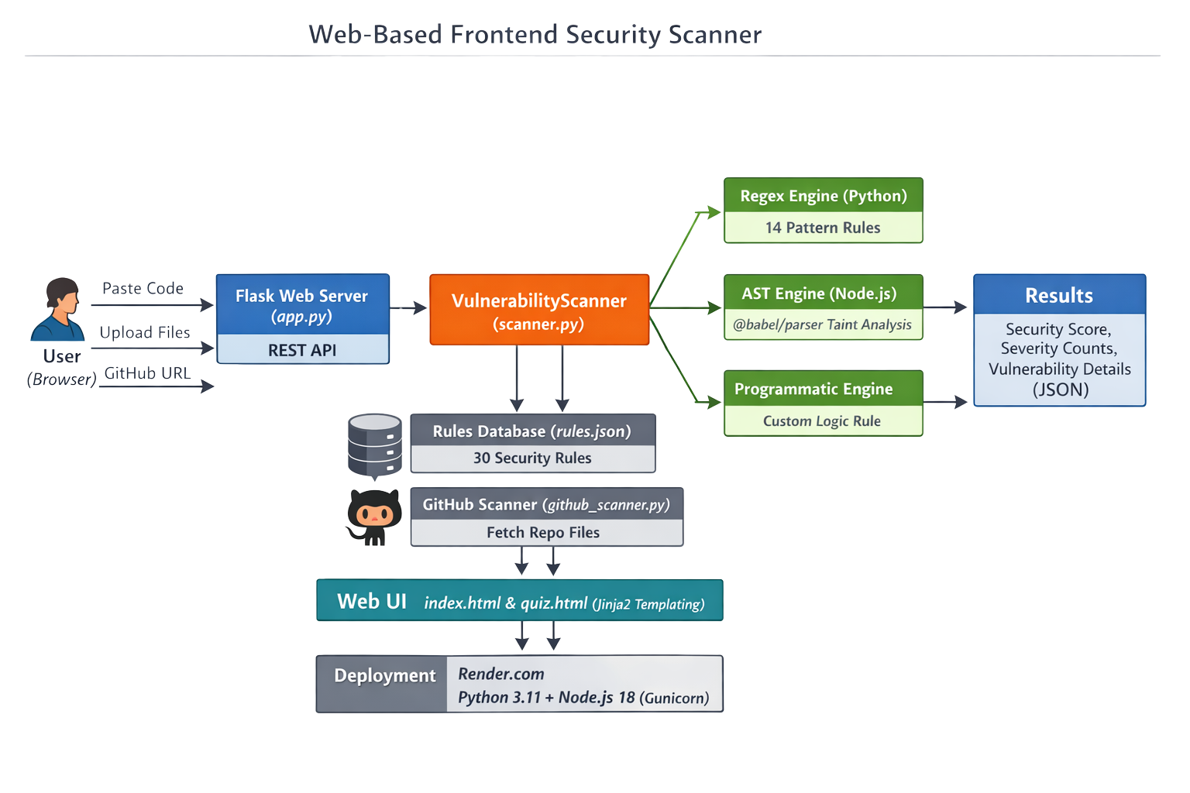

Slide 6
DETECTION METHODS
AST
Programmatic
Regex
  Uses pattern matching to detect known insecure code patterns
  Fast and effective for simple, recognizable issues
  Best for vulnerabilities that appear as direct text patterns
Examples
  Hardcoded secrets
  Insecure HTTP requests
  Weak randomness
  Parses JavaScript into a structured syntax tree
  Understands how code is organized and executed
  Tracks user-controlled data from sources to dangerous sinks
Example
  location.search → innerHTML
  Uses custom rule logic written in Python
  Handles security checks that do not fit regex or AST analysis
  Adds flexibility to the scanner
Example
  Detecting a missing Content Security Policy (CSP)

Slide 7
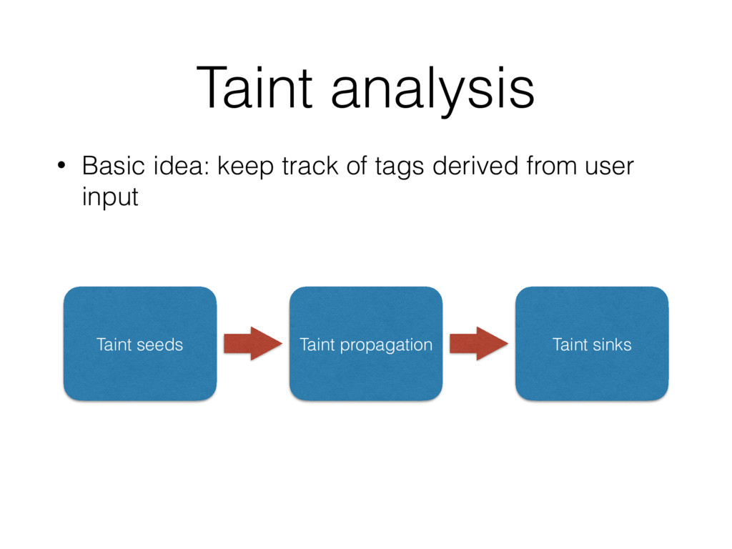
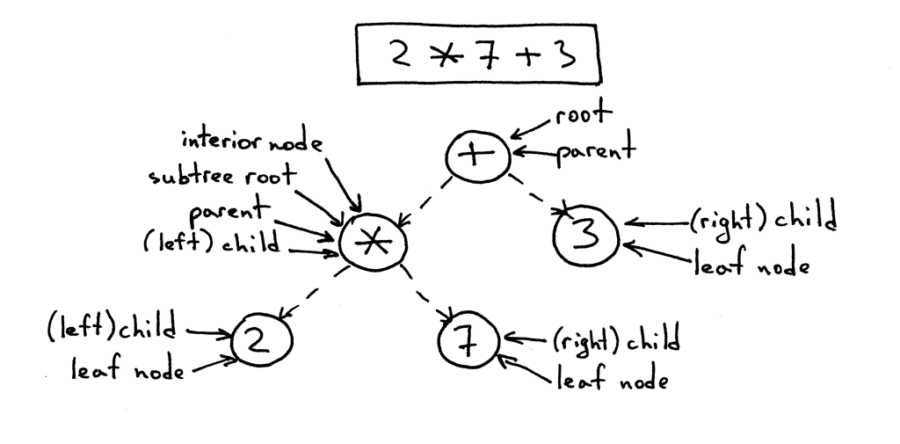
AST-Based Taint Analysis
Taint analysis is a technique used to track untrusted input as it flows through a program. It helps identify when that input reaches a sensitive or dangerous operation, potentially causing a security vulnerability.

Slide 8
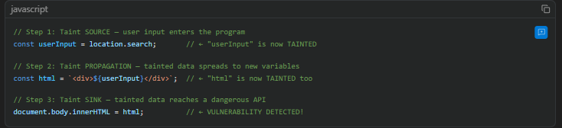
AST-Based Taint Analysis Example
Source
  User-controlled input enters the application
Propagation
  Input is passed into another variable or HTML content
Sink
  Tainted data reaches a dangerous DOM operation

Slide 9
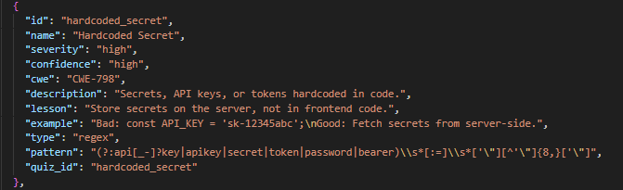
Rules for Detection
Rules are manual written inside rules.json and has pre-assigned severity based on how “dangerous” the vulnerability would be if exploited

Slide 10
Security Scoring
Each file is assigned a score of 100 and the score decreases based on:
  Severity of vulnerabilities
  Number of issues detected
Guardrails:
  Per-rule cap: Only the first 2 occurrences of the same rule count toward the score. So 10 console.log statements don't tank the score only the first 2 deduct points.
  Multi-file floor: When scanning multiple files, the overall score can't be more than 20 points above the worst file. This prevents many clean files from hiding one terrible file.

Slide 11
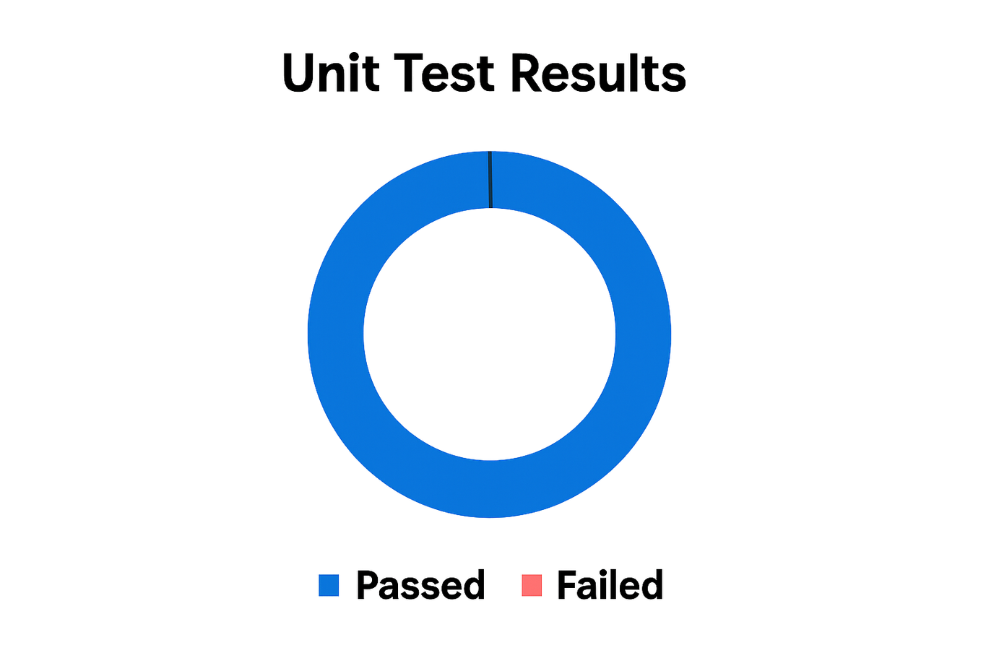
Results
The system was tested on vulnerable and secure code samples where it was able to detect a wide range of frontend vulnerabilities which covers multiple categories:
  XSS
  Insecure storage
  Hardcoded secrets
  Insecure HTTP usage

Slide 12
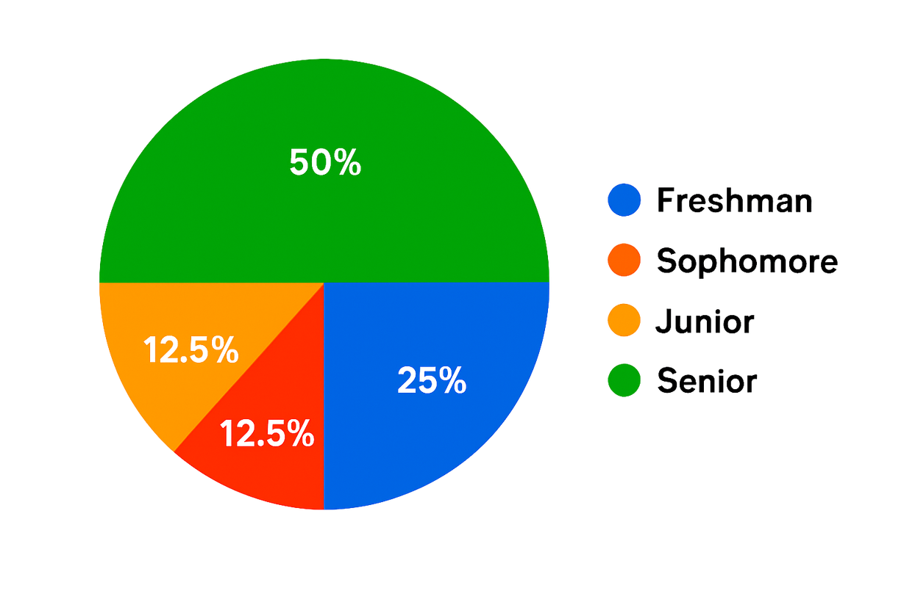
User Study Results
  8 participants completed the evaluation
  Mixed academic levels (Freshman → Senior)
  Moderate JavaScript familiarity
  Mixed background in secure coding training
User Study Participants

Slide 13
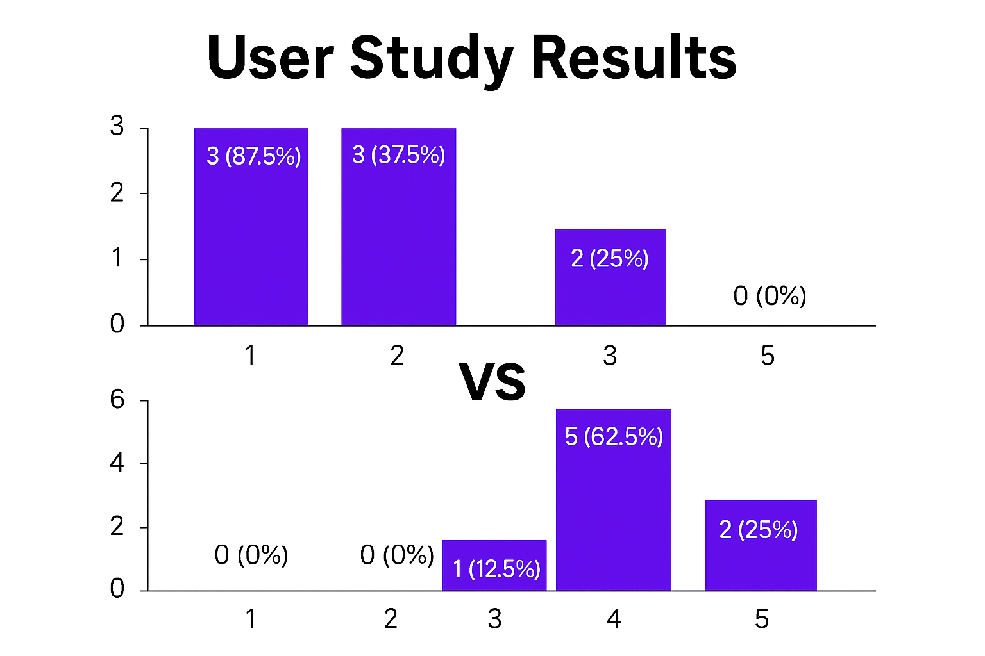
Before Vs After Scanner Confidence In Dectecting Vulnerabilities

Slide 14
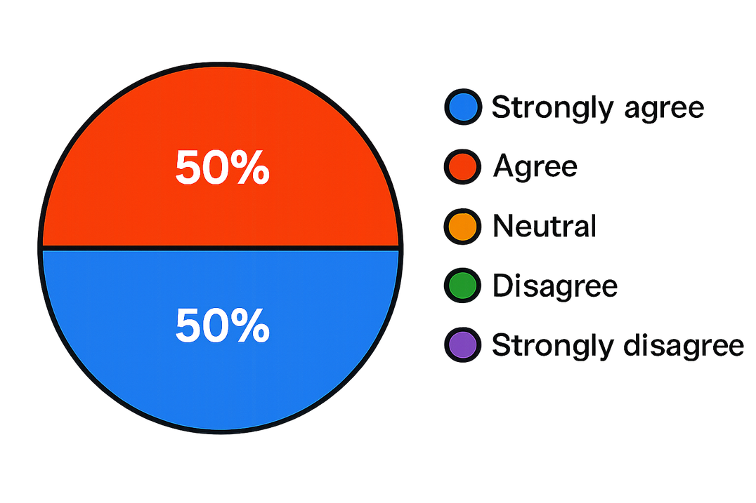
User Study Results
Most participants reported improved understanding, having learned:
How vulnerabilities occur
How to fix them
Explanations helped clarify security concepts
Reported Impact

Slide 15
DEMO

Slide 16
Limitations
  Single-file taint scope: Cannot track data flow across imported modules
  Doesn't consider if guards that sanitize input
  Regex limitations: Some patterns may cause false positives on comments/strings

Slide 17
Future Work
  Cross-file analysis: Track imports/exports for taint propagation across modules
  Framework-aware rules: React, Vue, Angular-specific vulnerability patterns
  IDE integration: VS Code extension for real-time scanning while coding
  Machine learning: Train a model on known-vulnerable code patterns to reduce false positives

Slide 18

Thank You
Happy To Take Questions!

