Slide 1
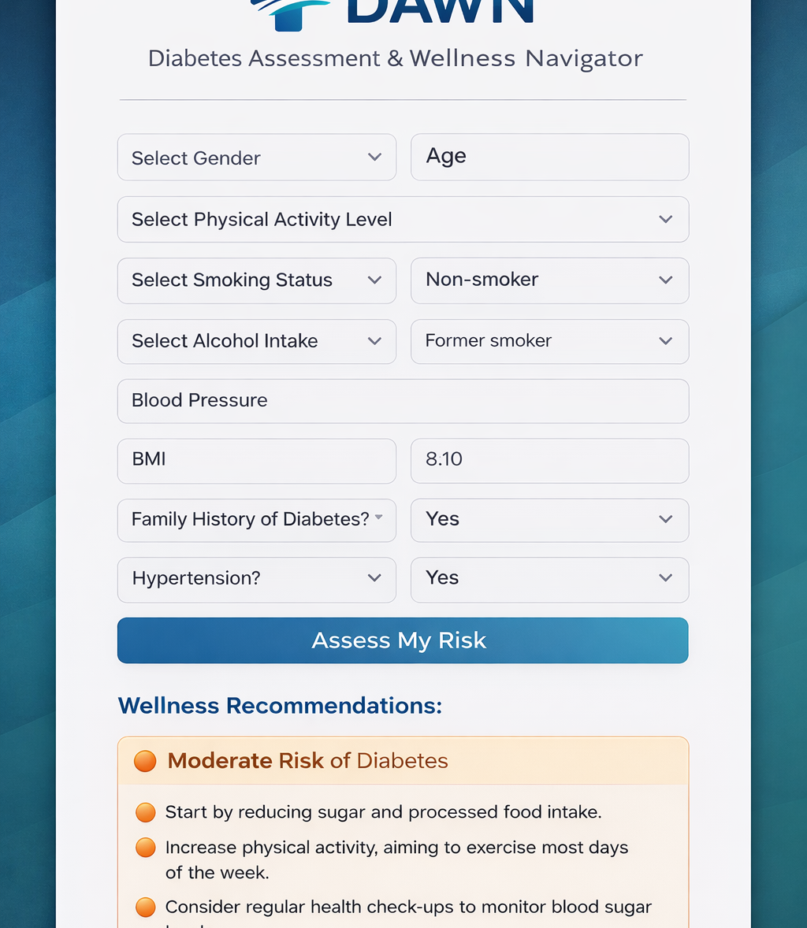
Predictive Analytics For Early Diabetes Detection & Management
Presenter: Felicia Forrester
Advisor: Dr. Karina Liles
Committee Members: Dr. Pratap Sahu, Dr. Shrikant Pawar

Slide 2
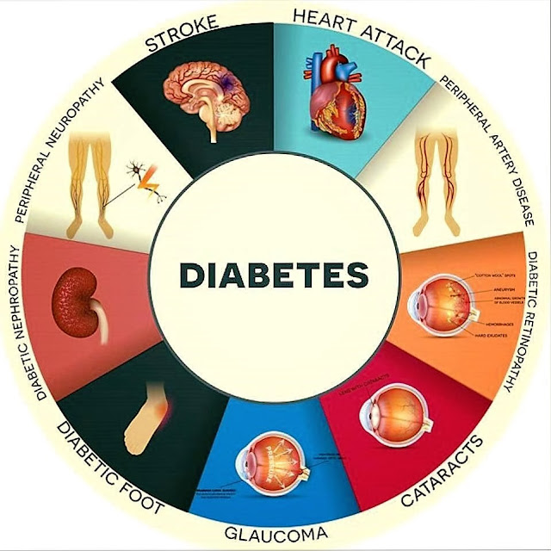
Background
Diabetes is a chronic condition that affects how the body regulates blood sugar (glucose). It occurs when the body either does not produce enough insulin or cannot use it effectively, leading to high blood sugar levels over time. If not properly managed, diabetes can cause serious health complications and requires early detection for better outcomes.
Includes Type 1, Type 2, and gestational diabetes.
Can lead to heart disease, kidney damage, and vision issues.
This Photo by Unknown Author is licensed under CC BY-NC-ND

Slide 3
Gap: Lack of early, data-driven tools to identify individuals at risk before diagnosis. Current methods rely on clinical testing and noticeable symptoms, limiting early intervention.
Limited use of predictive analytics in accessible, real-world healthcare settings. Hence, there is a need for a system that enables early risk detection and proactive decision-making
Problem
statement

Slide 4
Objective
This study aims to develop a predictive model that can identify individuals at risk of developing diabetes using data-driven techniques, enabling earlier detection and more informed healthcare decisions.
Build a machine learning model to predict diabetes risk
Utilize available health data to identify key risk factors
Improve early detection compared to traditional methods
Support proactive intervention and decision-making
Contribute to the use of technology in healthcare analytics

Slide 5
Research Questions
#1 | #2 | #3
How effective are technological tools in improving health awareness and outcomes for individuals at risk of diabetes? | Can predictive analytics help identify individuals who may develop diabetes in the future? | What factors most strongly influence model-based diabetes risk prediction?

Slide 6
Research Impact
This research matters because it focuses on improving early detection of diabetes through data-driven methods, which can help reduce the risk of severe complications and improve overall health outcomes.
Patients: Benefit from earlier risk identification and preventive care.
Healthcare providers: Gain tools to support better decision-making and early intervention.
Healthcare system: Potentially reduces costs associated with late-stage treatment.
Researchers/technology field: Encourages the use of machine learning in healthcare which promotes a shift from reactive treatment to proactive prevention.

Slide 7
What We Already Know
Early Risk Identification
Technology-Driven Health Engagement
High Predictive Capability
Role of Health & Lifestyle Factors
Data-driven approaches allow detection of risk before symptoms develop
Digital tools support increased awareness, monitoring, and user interaction
Variables such as glucose levels, BMI, and lifestyle patterns strongly influence prediction outcomes
Machine learning enables accurate identification of diabetes risk using health data

Slide 8
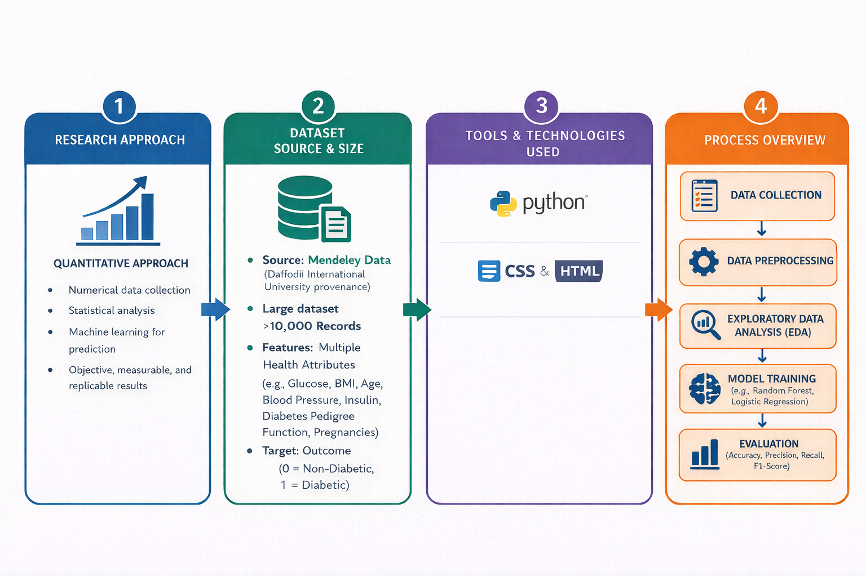
Research Design & Process

Slide 9
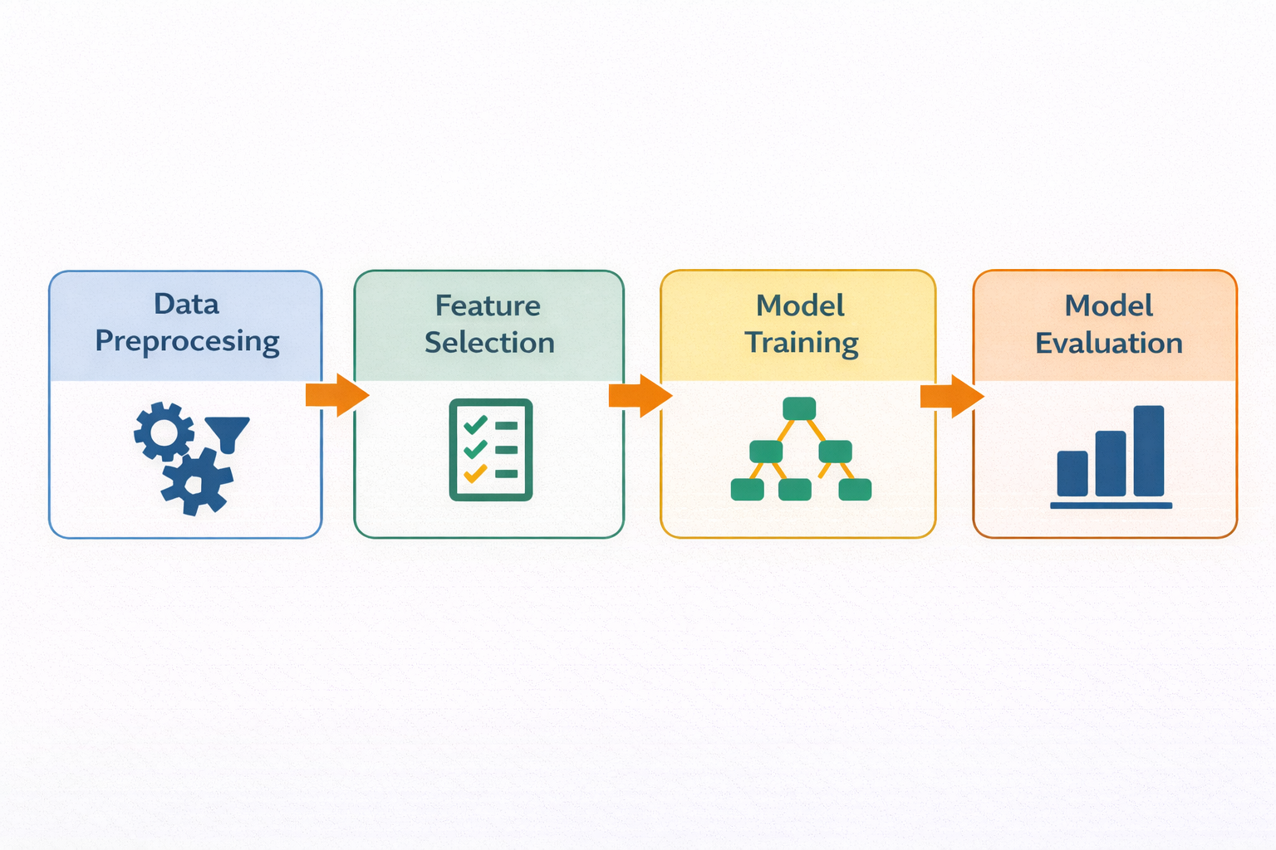
Model Design & Development
Data Source: Mendeley (Daffodil International University)
Data Preprocessing: Cleaning, missing values, normalization
Feature Selection: Glucose, BMI, Age, Blood Pressure
Train-Test Split: 80% / 20%
Model: Random Forest
Evaluation: Accuracy, Precision, Recall, F1-score

Slide 10

Results

Slide 11
Model Performance
Precision:
83.6%
ROC –AUC:
0.86
Accuracy:
83.7%
Recall:
98.7%
FF1- Score:
90.5%

Slide 12
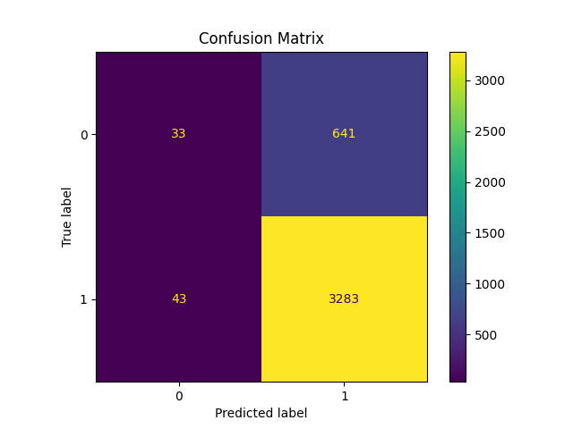
High true positives (3,283)
Low false negatives (43)
More false positives due to dataset imbalance

Slide 13
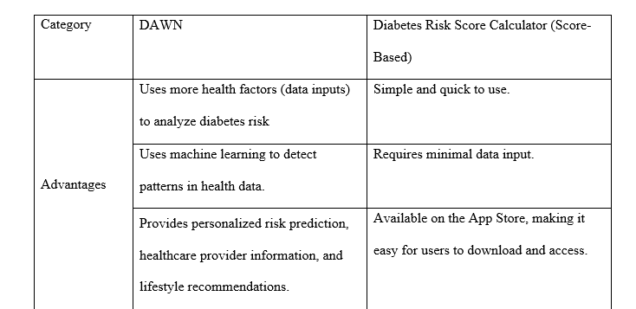
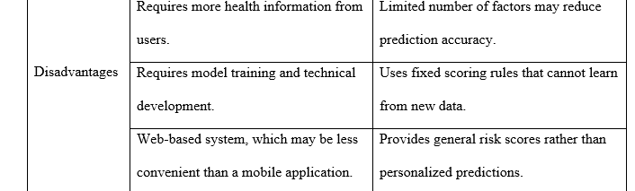
Comparison with Existing Tool
The DAWN system uses machine learning to analyze a wider range of health data and provide personalized risk predictions and recommendations. In contrast, traditional diabetes risk calculators rely on simple rule-based scoring with limited inputs, making them easier to use but less flexible and less personalize

Slide 14
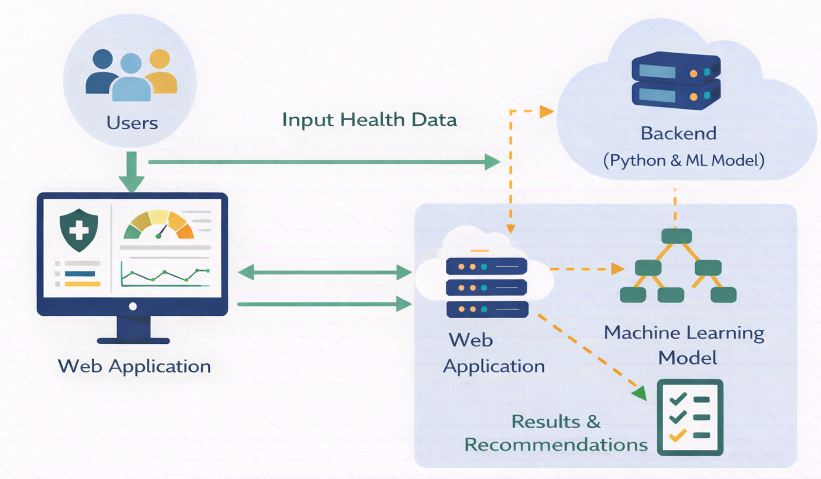
Web-Application: DAWN
The web-based application developed in this study is called DAWN (Diabetes Assessment & Wellness Navigator). It is designed to provide users with an accessible and user-friendly platform to assess their risk of developing diabetes. By allowing users to input key health-related information, the system leverages a machine learning model integrated within the backend to generate personalized risk predictions and basic lifestyle recommendations. The goal of DAWN is to promote early awareness and support proactive health decision-making through data-driven insights.

Slide 15
DEMO

Slide 16

Limitations
Dataset Limitations: Use of a secondary dataset may not fully represent all populations at risk for diabetes.
Lack of Real-World Validation: The system has not been tested in real healthcare settings or with real users.

Slide 17
Future Work
Expand Dataset: Use larger and more diverse datasets to improve model accuracy and generalizability
Model Enhancement: Explore and compare additional machine learning algorithms to improve performance
Real-World Testing: Conduct user testing to evaluate usability and effectiveness in real-life settings
System Expansion: Develop features like a healthcare provider portal and tools for ongoing diabetes management

Slide 18

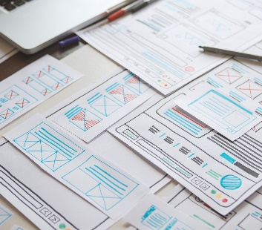

Thank you!
Any Questions?

Slide 19
References

