Slide 1

The Role of an Awareness App in Minimizing Cyberattacks at Claflin University
By: Destiny Blassingame
Department of mathematics and Computer science
Dr. Abdelrahman Desoky and Dr. Pratap Sahu

Slide 2
Abstract
Cybersecurity threats are increasing across colleges and universities, creating a need for better awareness tools.
This project focuses on creating a cybersecurity awareness app for students, faculty, and staff at Claflin University. The app includes interactive modules, phishing simulations, and simple, easy-to-understand instructions. These features help users learn how to recognize scams, protect their data, and practice safer online behavior. Using a mobile platform makes the training accessible and more engaging than traditional methods.
The study uses pre- and post-surveys and app analytics to measure how much users learn and how their behavior changes.
Overall, the app aims to improve cybersecurity knowledge, reduce risks, and support a safer digital environment on campus.

Slide 3
Introduction
Cybersecurity threats are rising in higher education, especially because universities have open networks and sensitive data.
Phishing and social engineering attacks are dangerous because they target people, not computer systems.
Many schools invest in strong security tools, but users often do not receive enough training.
Current awareness programs do not always create long-term changes in behavior.
Technical tools like spam filters help, but they cannot stop every attack or prevent users from clicking harmful links.
This shows the need for stronger cybersecurity awareness and training for students, faculty, and staff.

Slide 4
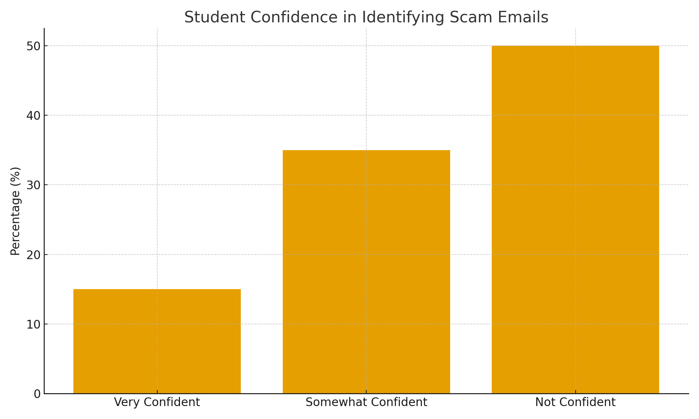
Background
Cybersecurity threats on campuses continue to evolve, making awareness training more important.
Research shows phishing is common because it exploits human behavior, not system flaws.
Many awareness programs measure knowledge, not actual behavior change.
Faculty and staff have different levels of technical skill, so “one-size-fits-all” training is not effective. Personalized cybersecurity training may lead to better long-term results.
Smaller schools like Claflin often lack the resources to build and measure advanced training programs.
This study focuses on how awareness efforts affect behavior at smaller institutions and aims to provide practical, low-cost strategies.

Slide 5
Purpose
To measure how effective Claflin University’s cybersecurity awareness programs are.
To see whether these programs lead to real behavior change among students and staff.
To identify gaps in current training and recommend improvements.
To compare interactive training methods (like gamification) with traditional approaches.
To provide evidence-based suggestions to improve cybersecurity education at small universities.

Slide 6
Research questions
Do cybersecurity awareness efforts at Claflin influence secure behavior among faculty and staff?
How well do current programs improve knowledge retention and long-term engagement?
Are interactive, customized training methods more effective than traditional training?
What strategies can improve cybersecurity awareness at Claflin University?

Slide 7
Population and Sampling
Target group: Claflin University undergraduate students (2024–2025).
Estimated student population: ~1,200 undergraduates.
Stratified random sampling across class levels and majors.
Sample size goal: 10–50 students for surveys and interviews.
Inclusion: enrolled undergraduates, age 18+, willing to complete training + assessments.
Exclusion: graduate students, minors, non-enrolled students, and those with prior formal cybersecurity training.

Slide 8
methodology
Measures how effective Claflin’s cybersecurity awareness programs are.
Examines whether training improves secure behavior and reduces cyber risks.
Identifies gaps in current training and evaluates customized learning approaches.

Slide 9

Research design
Development of a web-based cybersecurity awareness app.
Focuses on phishing and social engineering threats.
Created using HTML, CSS, JavaScript in Visual Studio Code.
Includes real-time phishing alerts, Q&A section, and sample phishing email examples.
Content based on real campus phishing reports and trusted sources (NCA, CISA).
This Photo by Unknown Author is licensed under CC BY-SA

Slide 10
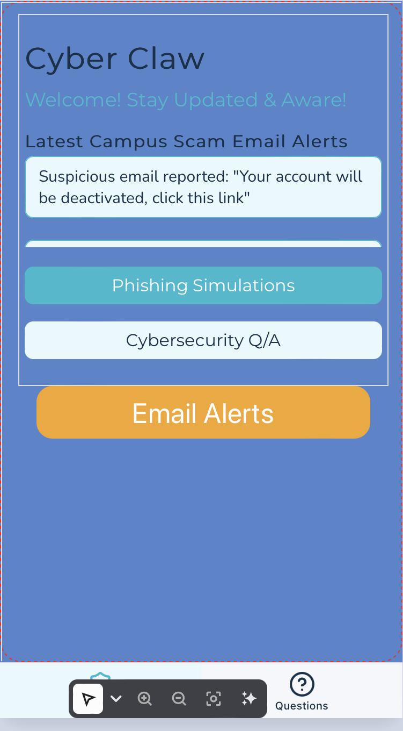
App design

Slide 11
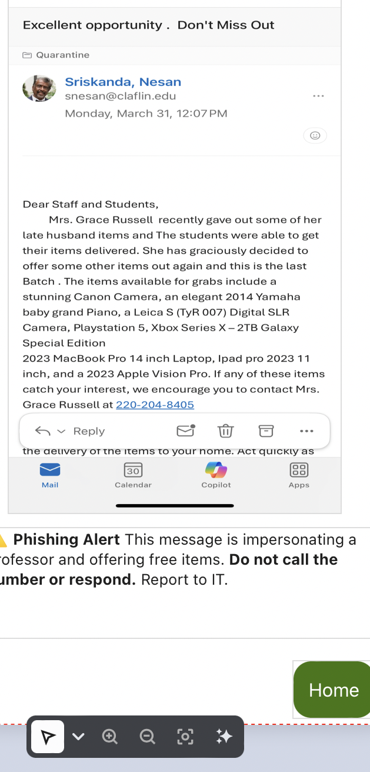
App design

Slide 12
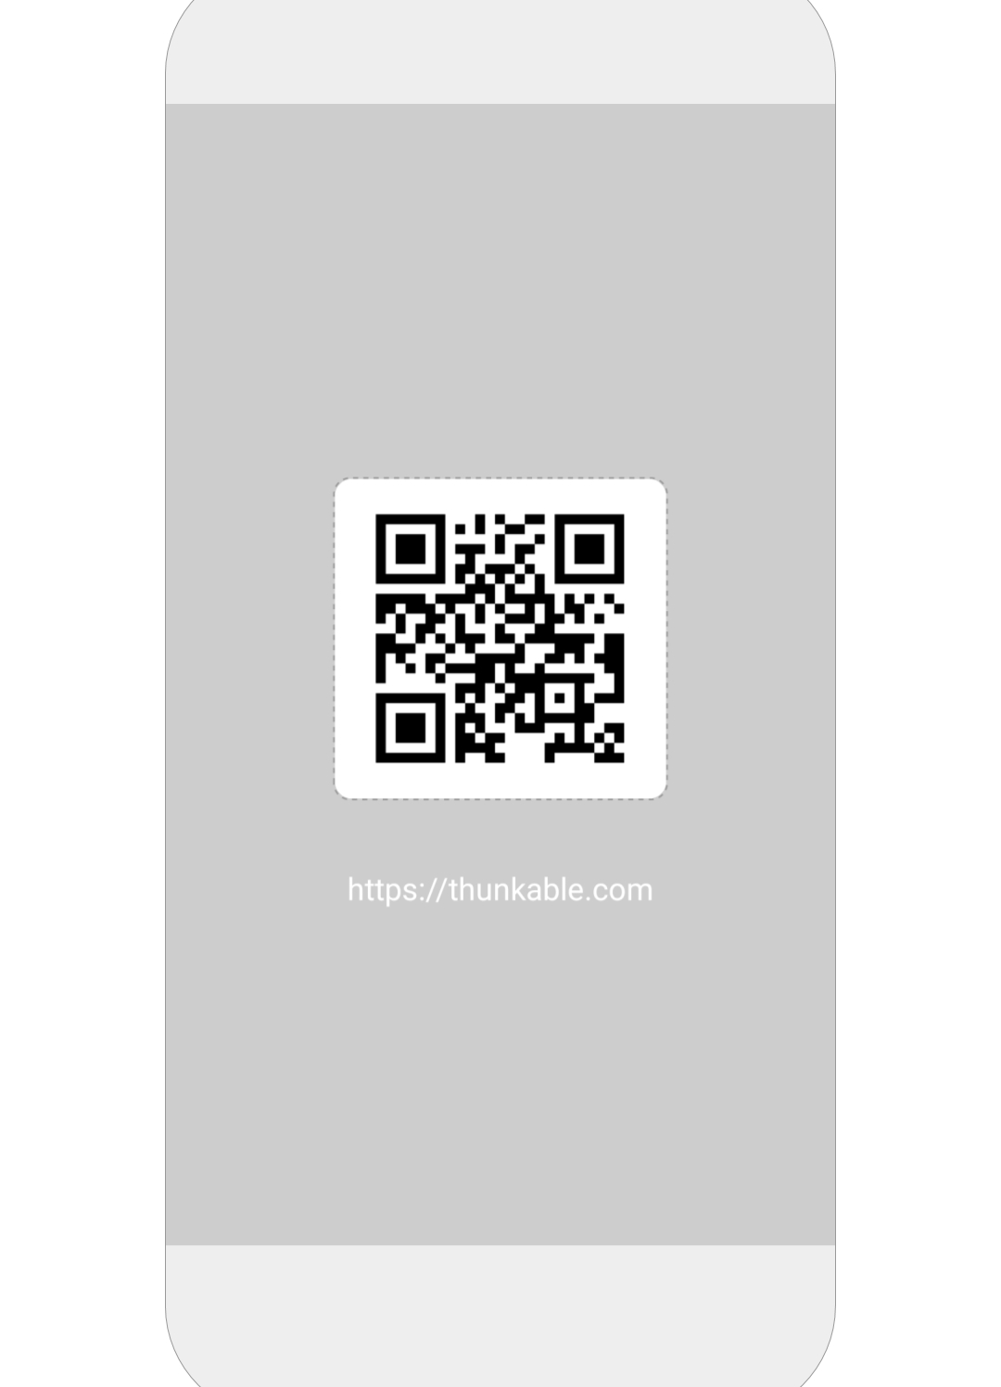
Scan qr to view app
https://x.thunkable.com/copy/520e4f5156f8c606194c9abca709ac74

Slide 13
Participant recruitment
Students invited through university email.
Effort made to include students from all academic levels and majors.
Expected participation: 10–50 students for training and surveys.

Slide 14
Data collection/Instrumentation
Pre- and post-surveys delivered via Google Forms. Measures changes in knowledge, behavior, and confidence. Platform analytics track time spent, module completion, and phishing simulation responses.
Optional short interviews provide additional feedback on usability and effectiveness. Debriefing provided at the end with cybersecurity best practices.
Custom survey with three main parts:
  Demographics: age, classification, major, prior experience.
  Knowledge questions: identify phishing red flags, suspicious URLs, sender issues, poor grammar, etc.
  Behavioral items: Likert-scale ratings on confidence and likelihood to report phishing.
Surveys administered before and after training to measure change.
Designed to assess both knowledge gained and behavioral intention.

Slide 15
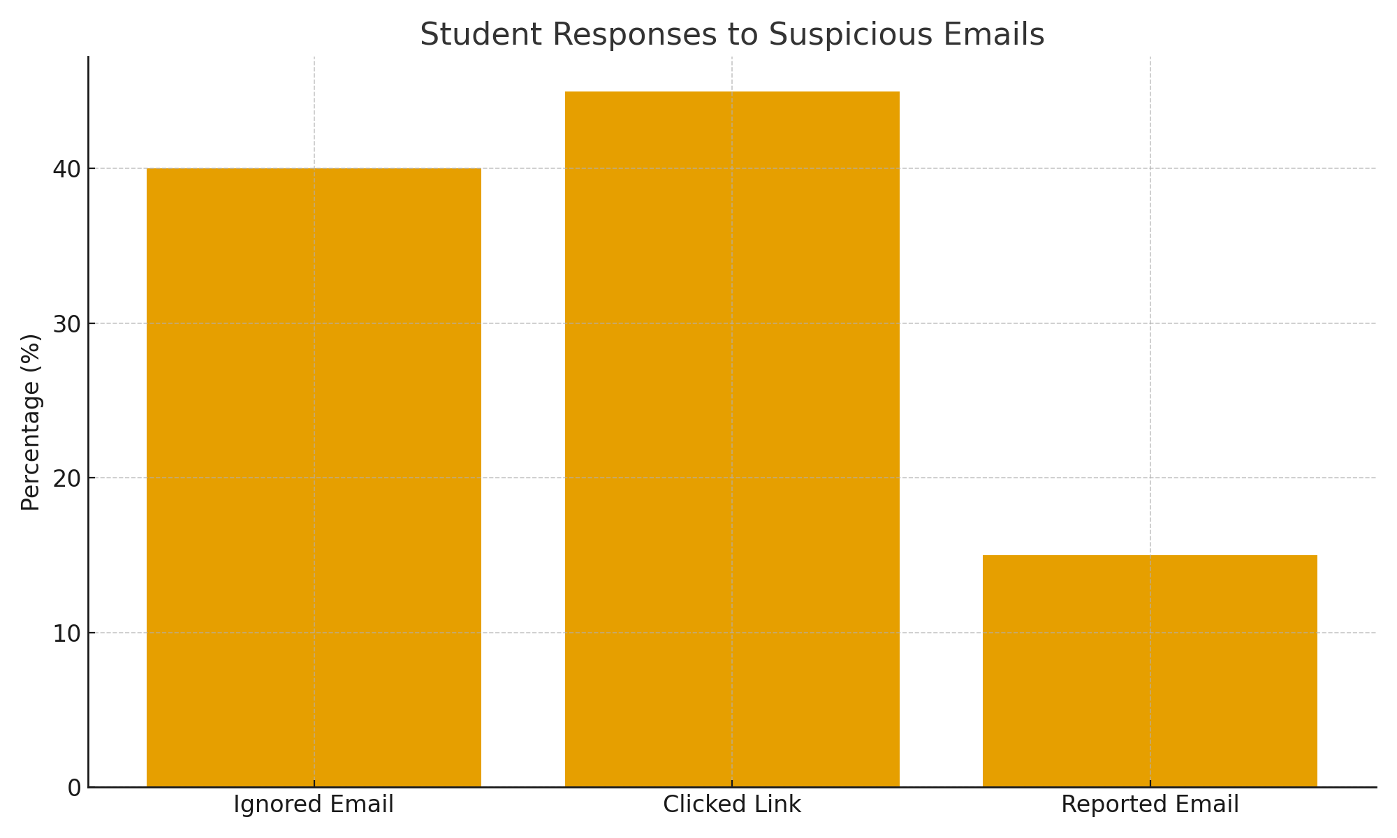
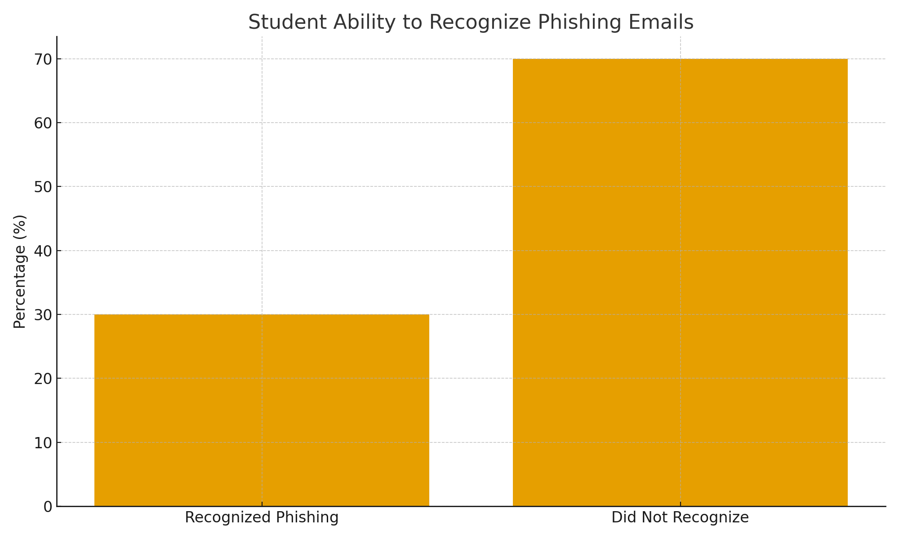
data
Student responses to suspicious emails, indicating whether participants ignored, interacted with, or reported potentially malicious messages.
Student ability to recognize phishing emails, showing that many respondents were unable to correctly identify fraudulent messages.

Slide 16
limitations
The study uses a small, institution-specific sample, which may limit how well the results apply to other universities.
Self-reported survey data may include response bias, such as participants overestimating their knowledge or confidence.
Prior exposure to cybersecurity (courses, jobs, personal experience) may influence results and cannot be fully controlled.
The short time between pre- and post-surveys may not measure long-term knowledge or behavior change.

Slide 17
limitations
Engagement with the training platform may vary based on learning style or comfort with digital tools.
Technical issues (internet connection, browser compatibility) may affect user experience and performance.
Voluntary participation may lead to selection bias, as students interested in cybersecurity may be more likely to participate.
Mixed-methods design, including interviews, helps explore these limitations and improves understanding for future improvements.

Slide 18
Global impact of computing solution
Impact on Individuals
Helps students, faculty, and staff recognize phishing scams and other digital threats.
Teaches safer online behaviors such as strong passwords, data privacy, and email safety.
Builds user confidence and awareness when navigating digital environments.
Encourages long-term cybersecurity habits through interactive learning.

Slide 19
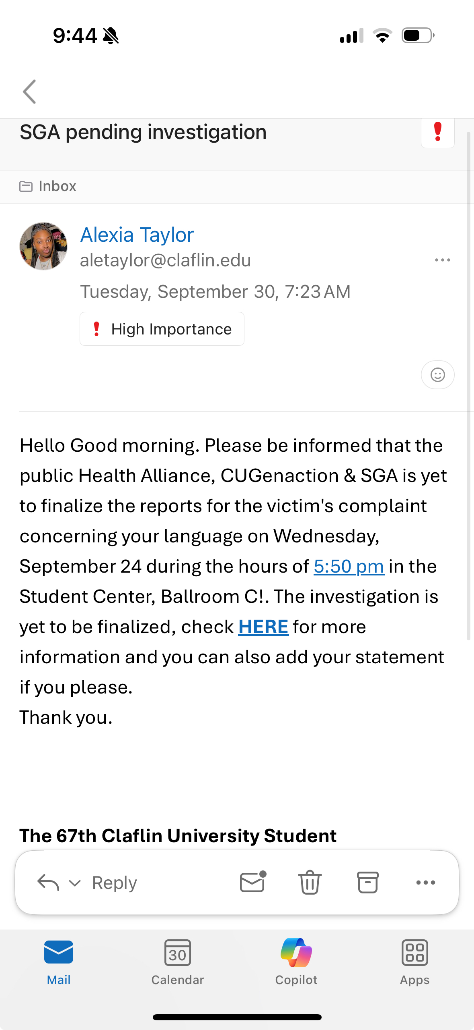
Example of scam email

Slide 20
Global impact of computing solution
Impact on Organizations (Claflin University)
Strengthens the university’s cybersecurity culture and reduces human-related security incidents.
Supports compliance with institutional security policies and the NIST Cybersecurity Framework.
Helps prevent financial losses, data breaches, and reputational damage.
Provides a cost-effective and scalable training tool for ongoing cybersecurity education.

Slide 21
Global impact of computing solution
Impact on Society / Global Impact
Serves as a model for other universities facing similar phishing and social engineering threats.
Shows how local digital solutions can improve global cybersecurity awareness.
Contributes to broader efforts to reduce cybercrime by improving user behavior.
Encourages a proactive, educated community that can better identify and respond to cyber risks.

Slide 22
Recommendations
Future studies should involve multiple universities to improve generalizability.
Research long-term effects of cybersecurity awareness programs on user behavior.
Use behavioral analytics or simulated phishing exercises to assess progress objectively.
Explore gamification or interactive features to boost engagement and retention.
Include interviews with faculty and IT staff for deeper insights into institutional culture.
Ensure ethical standards: privacy, informed consent, and data confidentiality.

Slide 23
conclusions
Claflin University’s cybersecurity awareness programs improve knowledge, but gaps remain.
The Cybersecurity Awareness App “Cyber Claw” provides interactive, practical training on phishing and safe online behavior.
The app fosters a culture of security among students, faculty, and staff.
Combining education with technology and policy aligns with best practices (e.g., NIST Cybersecurity Framework).
Future improvements: long-term studies, gamified or customized learning, and multi-institution research.
Overall, the app promotes digital literacy, responsibility, and resilience at both institutional and global levels.

Slide 24
References/sources
Aloul, F. A. (2012). The need for effective information security awareness. Journal of Advances in Information Technology, 3(3), 176–183. https://doi.org/10.4304/jait.3.3.176-183
Bada, M., Sasse, A. M., & Nurse, J. R. C. (2019, January 9). Cyber security awareness campaigns: Why do they fail to change behaviour? arXiv.org. https://doi.org/10.48550/arXiv.1901.02672
Conteh, N. Y., & Schmick, P. J. (2016, February 10). Cybersecurity: Risks, vulnerabilities, and countermeasures to prevent social engineering attacks. ResearchGate. https://www.researchgate.net/publication/294421084_Cybersecurityrisks_vulnerabilities_and_countermeasures_to_prevent_social_engineering_attacks
Cybersecurity & Infrastructure Security Agency. (n.d.). Phishing guidance. https://www.cisa.gov/news-events/phishing-guidance
Hina, S., & Selvam, D. (2018, March 30). Information security policies’ compliance: A perspective for higher education institutions. Journal of Computer Information Systems, 60, 201–211. https://www.scirp.org/reference/referencespapers?referenceid=3352890
National Institute of Standards and Technology. (2022). NIST cybersecurity framework. https://www.nist.gov/cyberframework
Yerby, J., & Floyd, K. (2018, August 30). Faculty and staff information security awareness and behaviors. Journal of The Colloquium for Information Systems Security Education. https://cisse.info/journal/index.php/cisse/article/view/90

Slide 25

Thank you!
Questions?

