Slide 1
Machine learning techniques for analyzing and interpreting genomics, proteomics & biomedical imaging data
Shrikant Pawar, MS., Ph.D.
Department of Computer Science and Biology, Claflin University
Claflin Faculty Profile: https://www.claflin.edu/academics-research/faculty-research/meet-our-faculty/dr.-pawar-shrikant
Lab Website: https://www.claflin-computation.com/

Slide 2
Bioinformatics/
Computational Biology
Sequence Analysis
Structural Biology
Network/Systems Biology
Databases, Software Development & Simulations
NGS: Machine Learning Application
NGS: Supervised Clustering Application
X-ray Crystallography on HIV-1 Protease
Indispensable Proteins in P. mirabilis
Cancer Drug Targets
RodentSQL,
Electronic Lab Notebook
Simulation study:
DEVS-JAVA Model
Microarray Analysis
Computer Vision
Machine Learning in CAD/Imaging dataset

Slide 3
Sequence Analysis: NGS
Utilizing neural networks (Restricted Boltzmann machine’s) and clustering algorithms to identify certain important, representative HIV-1 PR sequences from a pool of several hundred sequences.
Analysis of drug resistance in HIV protease, Shrikant Pawar, Chris Freas, Robert W. Harrison, and Irene T. Weber, BMC: Bioinformatics
Structural studies of antiviral inhibitor with HIV-1 protease bearing drug resistant substitutions of V32I, I47V and V82I, Shrikant Pawar, Yuan-FangWang, Andres Wong-Sam, Johnson Agniswamy, Arun K. Ghosh, Robert W. Harrison, and Irene T. Weber, Elsevier: Biochemical and Biophysical Research Communications

Slide 4
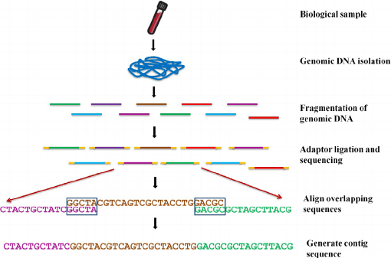
Next Generation Sequencing Technology (NGS): Align unknown sample contig sequence with known entire human genome to understand known and unknown genes

Slide 5
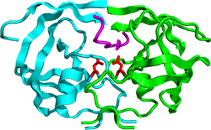
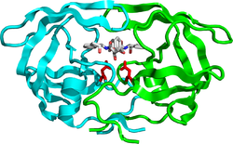
HIV-1 Protease Action
Hydrolyze peptide bonds
on the Gag-Pol polyproteins
Mature, fully functional
proteins
Infectious viral
particle
HIV-1 Protease
Competitive inhibition of PR prevents
virus maturation
Protease inhibitor: DRV
No infectious viral particle

Slide 6
Drug resistance is a severe problem
Patient 1
Patient 2
Patient 3
Patient 4
PQVTLWQRPI VTIKIGGQLK EALLDTGADN TVLEEMSLPG KWKPKMIGGI GGFIKVRQYD QVSIEICGHI AIGTVLIGPT PVNIIGRNLL TQLGCTLNF
Patient 5
Patient 6
Patient 7
Patient n
~100,000 sequences
Major and minor mutations
associated with resistance to all clinical protease inhibitors
Adapted from Weber, Kneller, Wong-Sam. Future Med Chem 2015

Slide 7

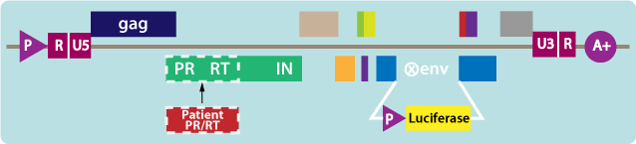
Phenotype Data
Genotype Data
Next-generation deep sequencing
Overall 5000 isolates for PI, NRTI
Resistance Fold
Seq ID FPV IDV NFV SQV ~100,000 sequences can be classified as resistant or non-resistant
12861 0.4 0.5 7.1 0.5
PQVTLWQRPI VTIKIGGQLK EALLDTGADN TVLEEMSLPG KWKPKMIGGI GGFIKVRQYD QVSIEICGHI AIGTVLIGPT PVNIIGRNLL TQLGCTLNF
>3 Resistant sequence/1; <3 Non-resistant sequence/0
Can machine learning help in selecting few drug resistant PR sequences for structure guided drug design?

Slide 8
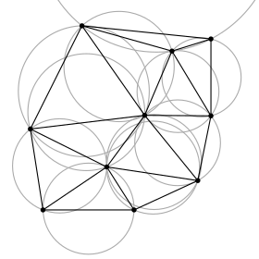
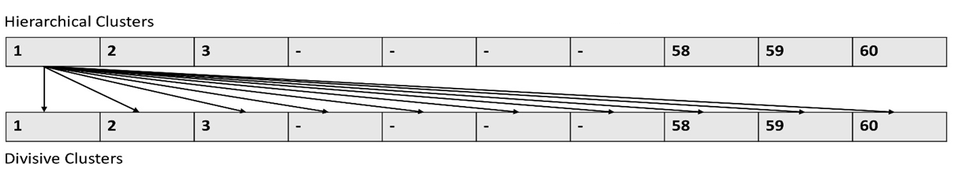
Analysis Pipeline
Coordinates for WT HIV-1 PR with its protein sequence information
Encode WT protein sequence and structure with Delaunay triangulation
Represent all the isolate sequences from Stanford database in form of 210 vectors
Apply RBM, SVM and RF for checking encoding accuracy
K means, Agglomerative and Divisive Clustering
Select sequences using intersection amongst techniques
Encoding Selection

Slide 9
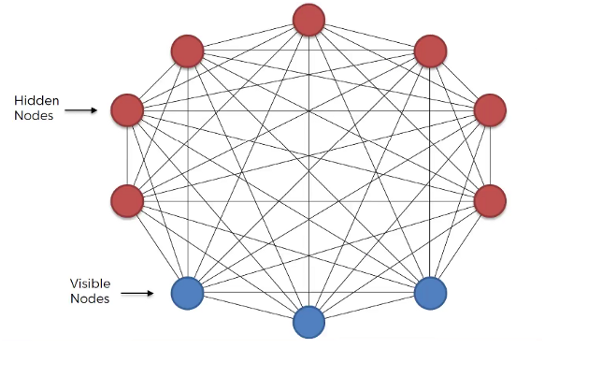
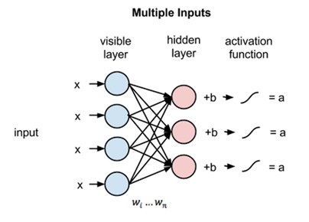

What are Restricted Boltzmann Machines?
Equation 1
Boltzmann Machines Restricted Boltzmann Machines
Equation 1: h(1) and v(0) are the corresponding vectors (column matrices) for the hidden and the visible layers
with the superscript as the iteration v(0) means the input that we provide to the network) and a is the hidden
layer bias vector.
Notes:
https://medium.com/machine-learning-researcher/boltzmann-machine-c2ce76d94da5

Slide 10
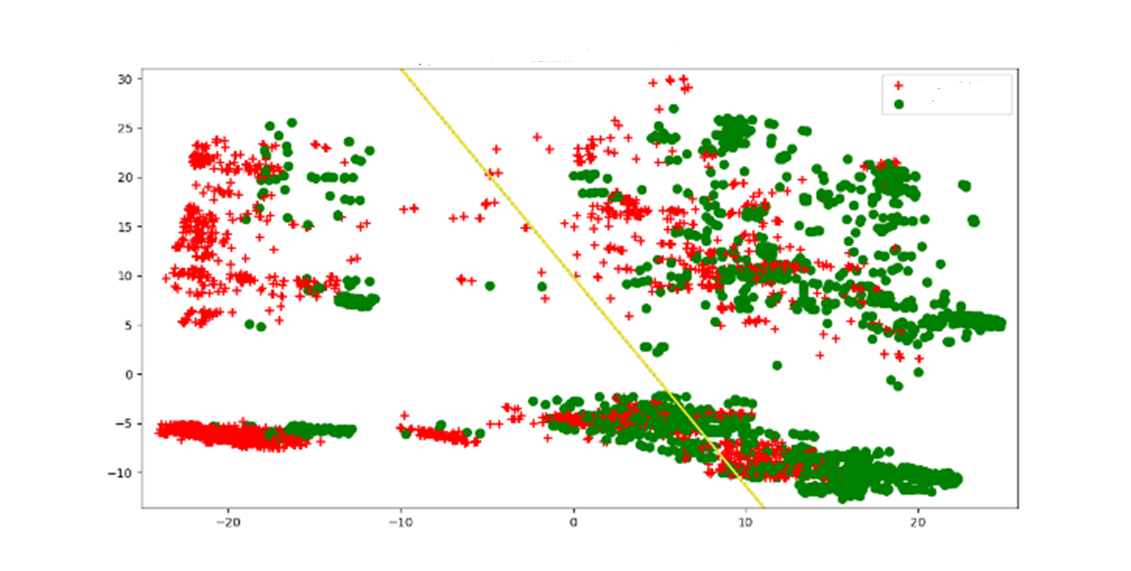
Efficient encoding: Representative plot with separation of sequences for inhibitor FPV with Support Vector Machine
Resistant Sequences
Non-Resistant Sequences
X and Y axis are weight vectors
Three, five- and ten-fold accuracies for SVM and RF ranged from 0.95-0.99. RBM also selected sequences in range 0.91-0.97.
These accuracies are better than Yu. Et. al. 2014 where she got SVM accuracies ranging from 0.93-0.96.
These accuracies are comparable with Shen. Et. al. 2016 where he got RF accuracies ranging from 0.98-0.99.

Slide 11
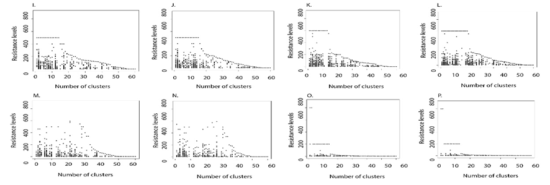
Sequence selection: Most of the high resistance fold sequences with class 2 were clustered in first 10 clusters for most of the selected inhibitors through both hierarchical and divisive clustering delineating a clean separation between non-resistant and resistant sequences.
ATV DRV FPV IDV
LPV NFV SQV TPV
Divisive Clustering

Slide 12
From a pool of 100,000 only 2-35 sequences were selected common through all the 3 approaches
Category | ATV | DRV | FPV | IDV | LPV | NFV | SQV | TPV
H, D and K | 0 | 0 | 20 (66) | 0 | 35 (61) , 2 (31) | 2 (12) | 5 (58), 6 (63), 3 (73), 21 (85) | 0
Numbers in parenthesis are the cluster from which they were selected.
The resistance status of the selected sequences should be identified.
Minimum number of sequences selected for inhibitors, NFV, SQV or LPV would be some of the ideal candidates for testing in laboratory.

Slide 13
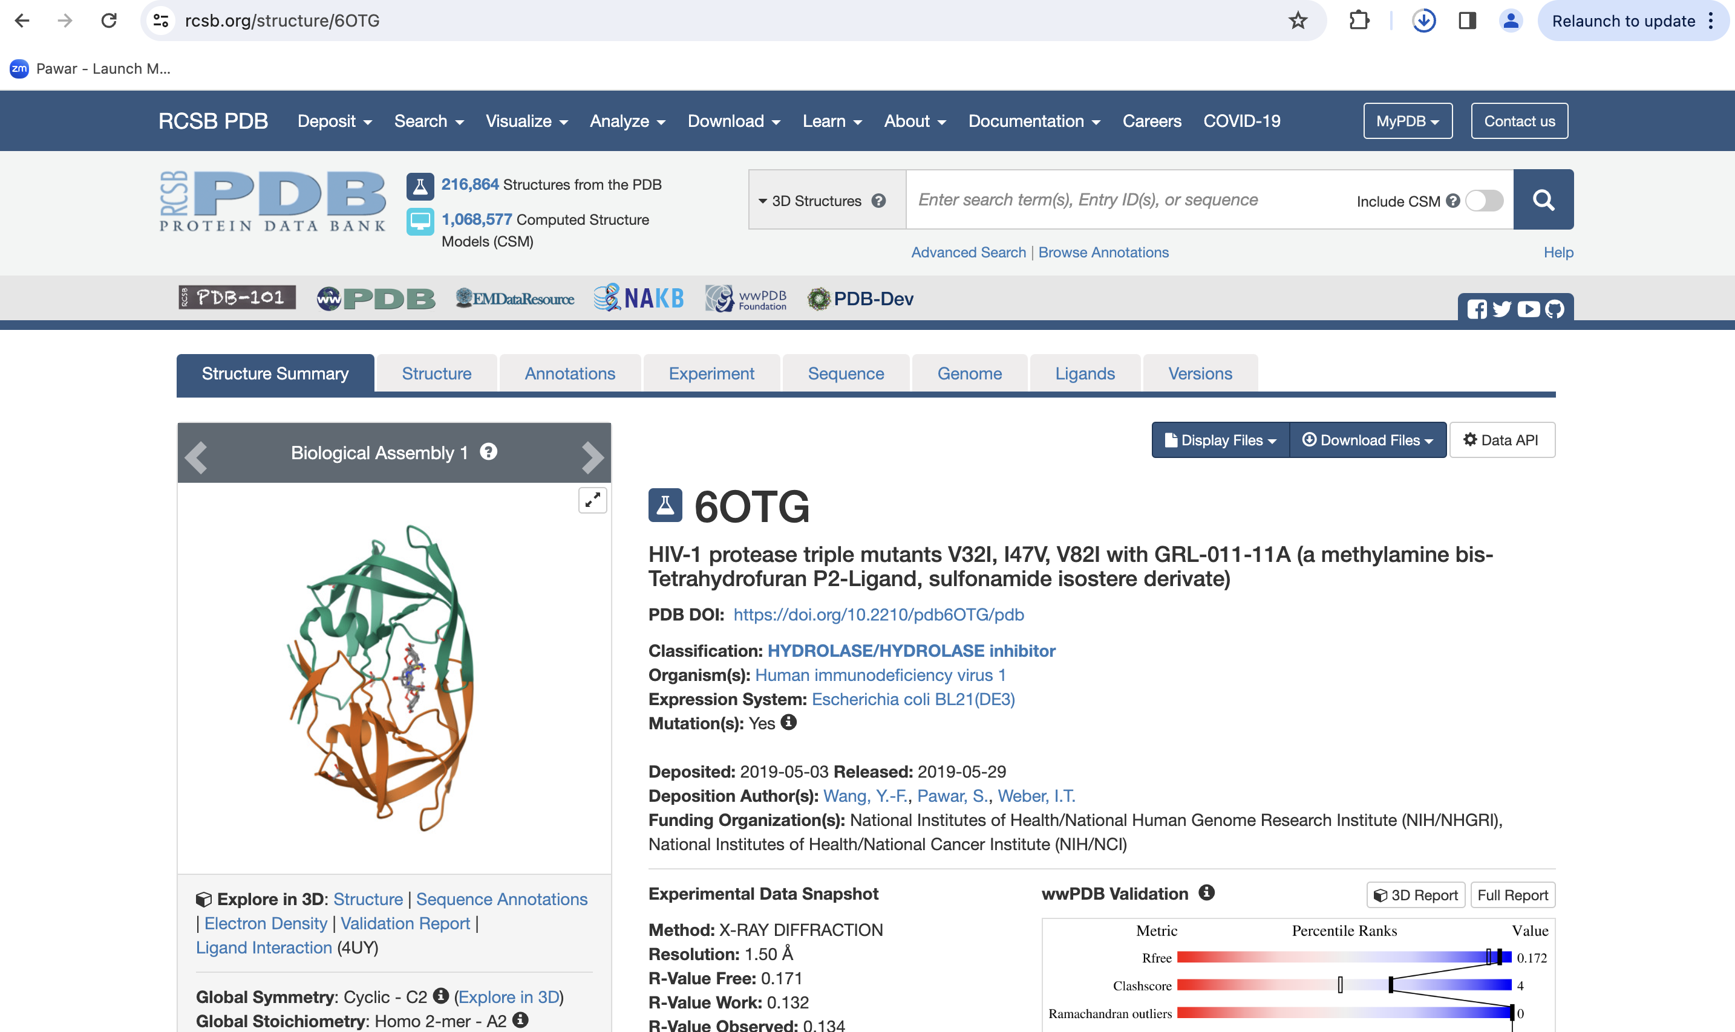
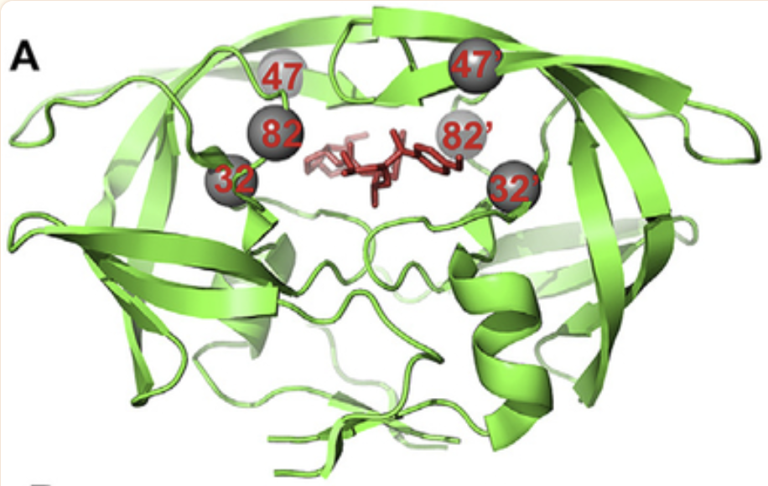
Validation of selected mutations
6OTG: HIV-1 protease triple mutants V32I, I47V, V82I with GRL-011-11A (a methylamine bis-Tetrahydrofuran P2-Ligand, sulfonamide isostere derivate): https://www.rcsb.org/structure/6OTG
This study examines the effects of four investigational inhibitors against HIV-1 protease with drug resistant mutations of V32I, I47V and V82I (PR _{Tri} ) that model the inhibitor-binding site of HIV-2 protease.
These inhibitors contain diverse chemical modifications on the darunavir scaffold and form new interactions with wild type protease, however, the measured inhibition constants for PR _{Tri} mutant range from 17 to 40 nM or significantly worse than picomolar values reported for wild type enzyme. The X-ray crystal structure of PR _{Tri} mutant in complex with inhibitor 1 at 1.5 Å resolution shows that the basic amine at P2 of inhibitor together with mutation V82I induces two alternate conformations for the side chain of Arg8 with new interactions with inhibitor and Leu10. Hence, inhibition is influenced by small coordinated changes in hydrophobic interactions.

Slide 14
Sequence Analysis: Microarray
KIFCI, a novel putative prognostic biomarker for ovarian adenocarcinomas.
3. KIFCI, a novel putative prognostic biomarker for ovarian adenocarcinomas: delineating protein interaction networks and signaling circuitries, Shrikant Pawar, Shashikiran Donthamsetty, Vaishali Pannu, Padmashree Rida, Angela Ogden, Nathan Bowen, Remus Osan, Guilherme Cantuaria, and Ritu Aneja, BMC: Journal of Ovarian Research
4. A centrosome clustering protein, KIFC1, predicts aggressive disease course in serous ovarian adenocarcinomas, Karuna Mittal, Da Hoon Choi, Sergey Klimov, Shrikant Pawar, Ramneet Kaur, Anirban K. Mitra, Meenakshi V. Gupta, Ralph Sams, Guilherme Cantuaria, Padmashree C. G. Rida, Ritu Aneja, BMC: Journal of Ovarian Research

Slide 15
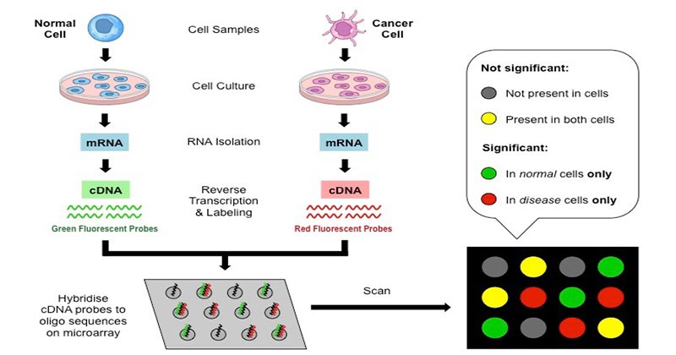
Microarray technology

Slide 16

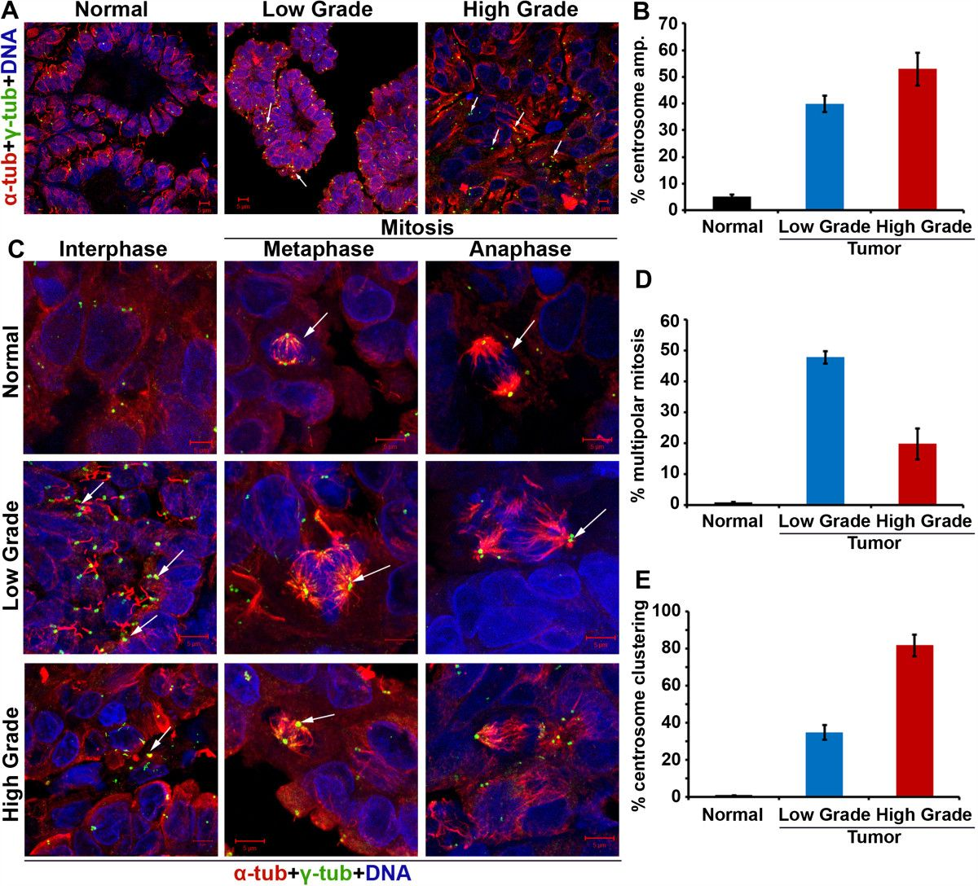
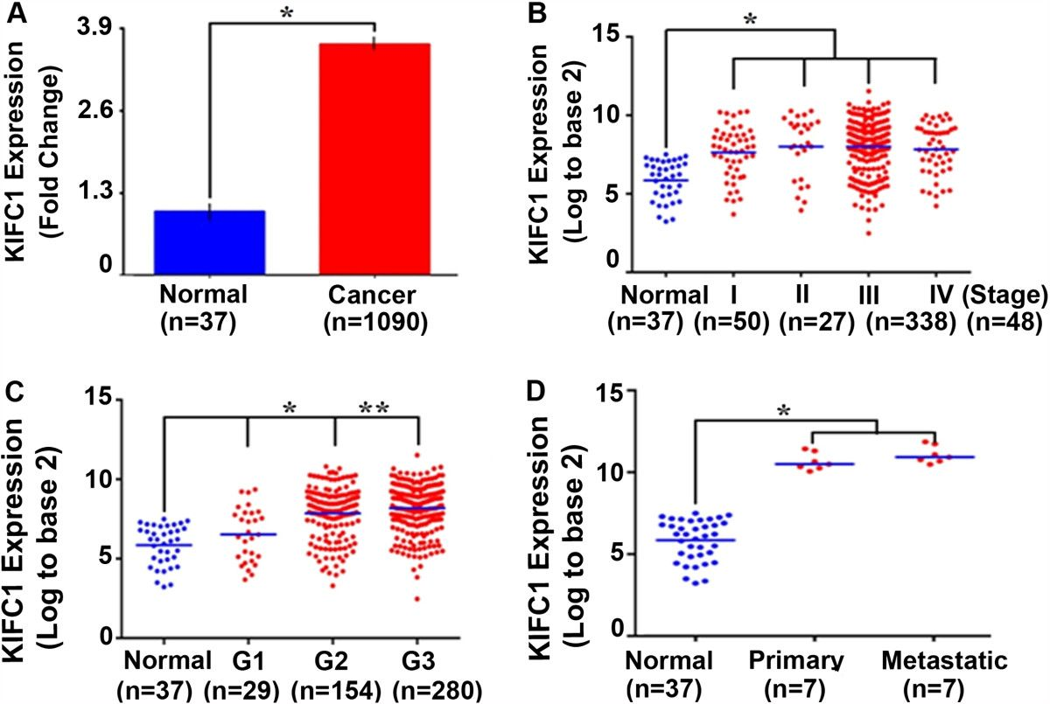
Centrosome amplification in ovarian cancer and high KIFC1 expression in ovarian cancer and normal tissue.

Slide 17
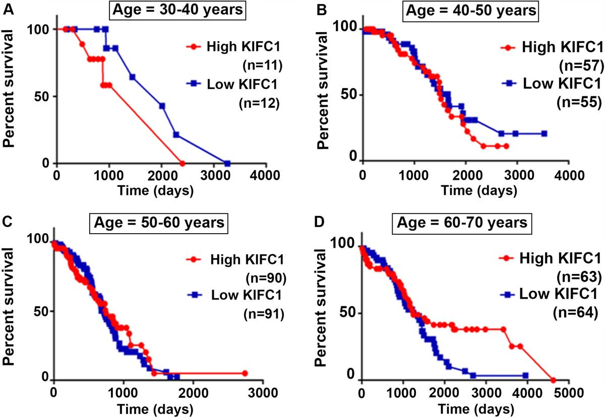
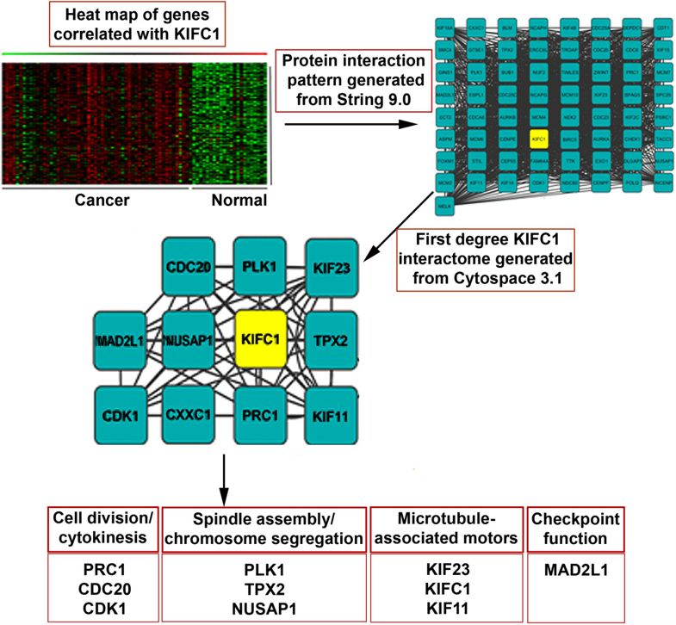
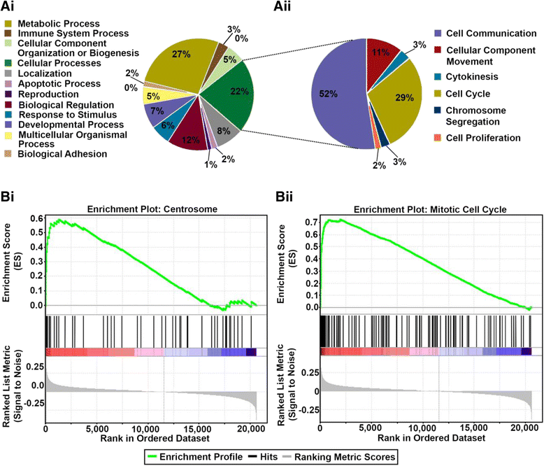
Increased KIFC1 expression is associated with poorer overall survival in age-specific ovarian cancer patients and pathways associated with first degree neighbors of KIFC1 protein
KM Survival Analysis
Protein Interactions
GSEA Analysis

Slide 18
Computer Vision in Biomedical Imaging
Single shot detector application for image disease localization
Single shot detector application for image disease localization, Shrikant Pawar, Rushikesh Chopade, Aditya Stanam, bioRxiv
Cyclical Learning Rates (CLR’S) for Improving Training Accuracies and Lowering Computational Cost, Shrikant Pawar, Rushikesh Chopade, Aditya Stanam, Springer Lecture Notes in Computer Science
System and method to detect lung disorders in chest x-ray image: Patent Pending, ID-TEMP/E-1/26/2021-DEL & USPTO trademark application for ‘ChestAi’ (#88930063)

Slide 19
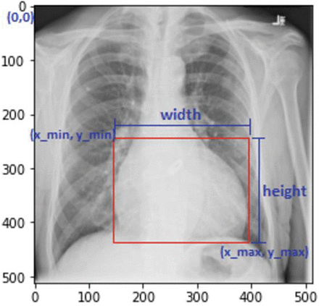
Bounding boxes for disease localization
Object localization is a subfield of computer vision that is used to detect the location of object in an image.
Bounding box algorithms are useful in localization of image patterns. Recently, utilization of convolutional neural networks on X-ray images has proven a promising disease prediction technique.

Slide 20
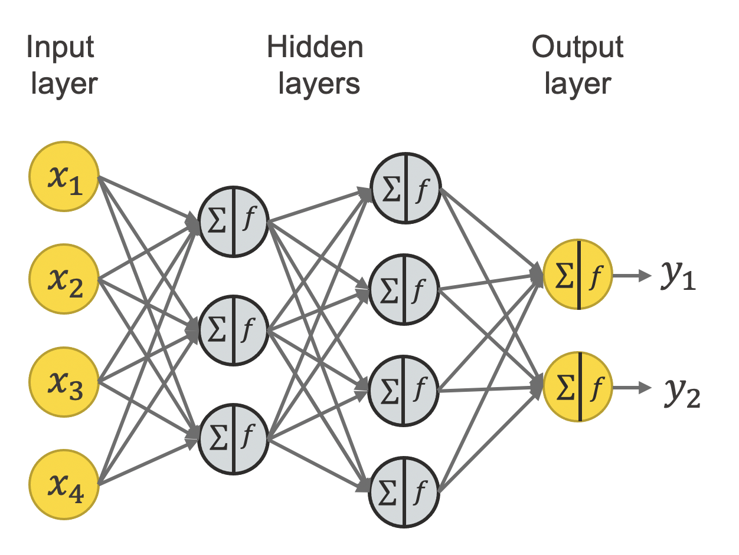
Neural Network architecture
Pattern captured in Output
Layer. Output layer stored as
a model
Unique pattern of cardiomegaly Passed into a network
Model is used for predicting
Patterns in new image

Slide 21
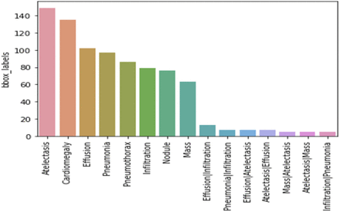
The dataset consists of 112,120 chest X-ray images, each image with a 1024*1024-pixel resolution. The images are divided into 15 classes (‘No Finding’, ‘Atelectasis’, ‘Cardiomegaly’, ‘Consolidation’, ‘Effusion’; ‘Emphysema’, ‘Edema’, ‘Fibrosis’, ‘Infiltration’, ‘Mass’, ‘Nodule’, ‘Pneumonia’, ‘Pneumothorax’, ‘Pleural Thickening’ and ‘Hernia’)

Slide 22
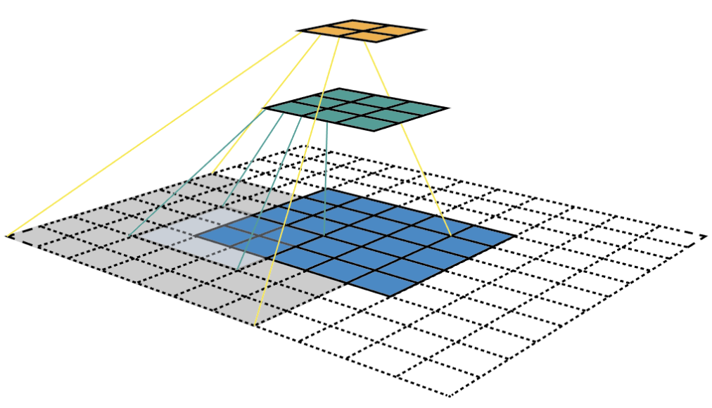
Single-Shot Detector (SSD) Method
VGG-16 with feature extractor
Grid cell
Anchor box
Aspect ratio
Zoom parameters
Rectified linear (ReLU) activation function
Custom cost function: classification loss & bounding box loss
Notes:
The rectified linear activation function is a simple calculation that returns the value provided as input directly, or the value 0.0 if the input is 0.0 or less.
The function is linear for values greater than zero, meaning it has a lot of the desirable properties of a linear activation function when training a neural network using backpropagation. Yet, it is a nonlinear function as negative values are always output as zero.
The 16 in VGG16 refers to 16 layers that have weights. In VGG16 there are thirteen convolutional layers, five Max Pooling layers, and three Dense layers which sum up to 21 layers but it has only sixteen weight layers
The localization loss is the mismatch between the ground truth box and the predicted boundary box. SSD only penalizes predictions from positive matches. We want the predictions from the positive matches to get closer to the ground truth. Negative matches can be ignored.
The confidence loss is the loss of making a class prediction. For every positive match prediction, we penalize the loss according to the confidence score of the corresponding class.
Techniques to Reduce Underfitting
Increase model complexity.
Increase the number of features, performing feature engineering.
Remove noise from the data.
Increase the number of epochs or increase the duration of training to get better results.
Overfitting in Machine Learning When a model gets trained with so much data, it starts learning from the noise and inaccurate data entries in our data set. And when testing with test data results in High variance. Then the model does not categorize the data correctly, because of too many details and noise.
Improving the quality of training data reduces overfitting by focusing on meaningful patterns, mitigate the risk of fitting the noise or irrelevant features.
Increase the training data can improve the model’s ability to generalize to unseen data and reduce the likelihood of overfitting.
Reduce model complexity.
Early stopping during the training phase (have an eye over the loss over the training period as soon as loss begins to increase stop training).
Ridge Regularization and Lasso Regularization.
Use dropout for neural networks to tackle overfitting.
SVM, RF supervised
CLustering un supervised

Slide 23
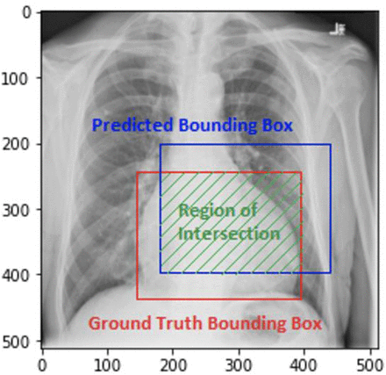
1. Image of a patient suffering from cardiomegaly showing intersection of original condition and prediction.
2. Its applications should be tested on other medical image datasets like computerized tomography, magnetic resonance image or even immunohistochemistry staining images.
3. Bounding boxes are one of the most popular image annotation techniques in deep learning, and with improvements in prediction accuracies, this method can reduce costs and increase annotation efficiency compared to other image processing methods.
The prediction accuracy is >95% (~10% improvement on training without SSD architecture), Patent Pending, ID-TEMP/E-1/26/2021-DEL
Notes:
IOU>0.5

Slide 24
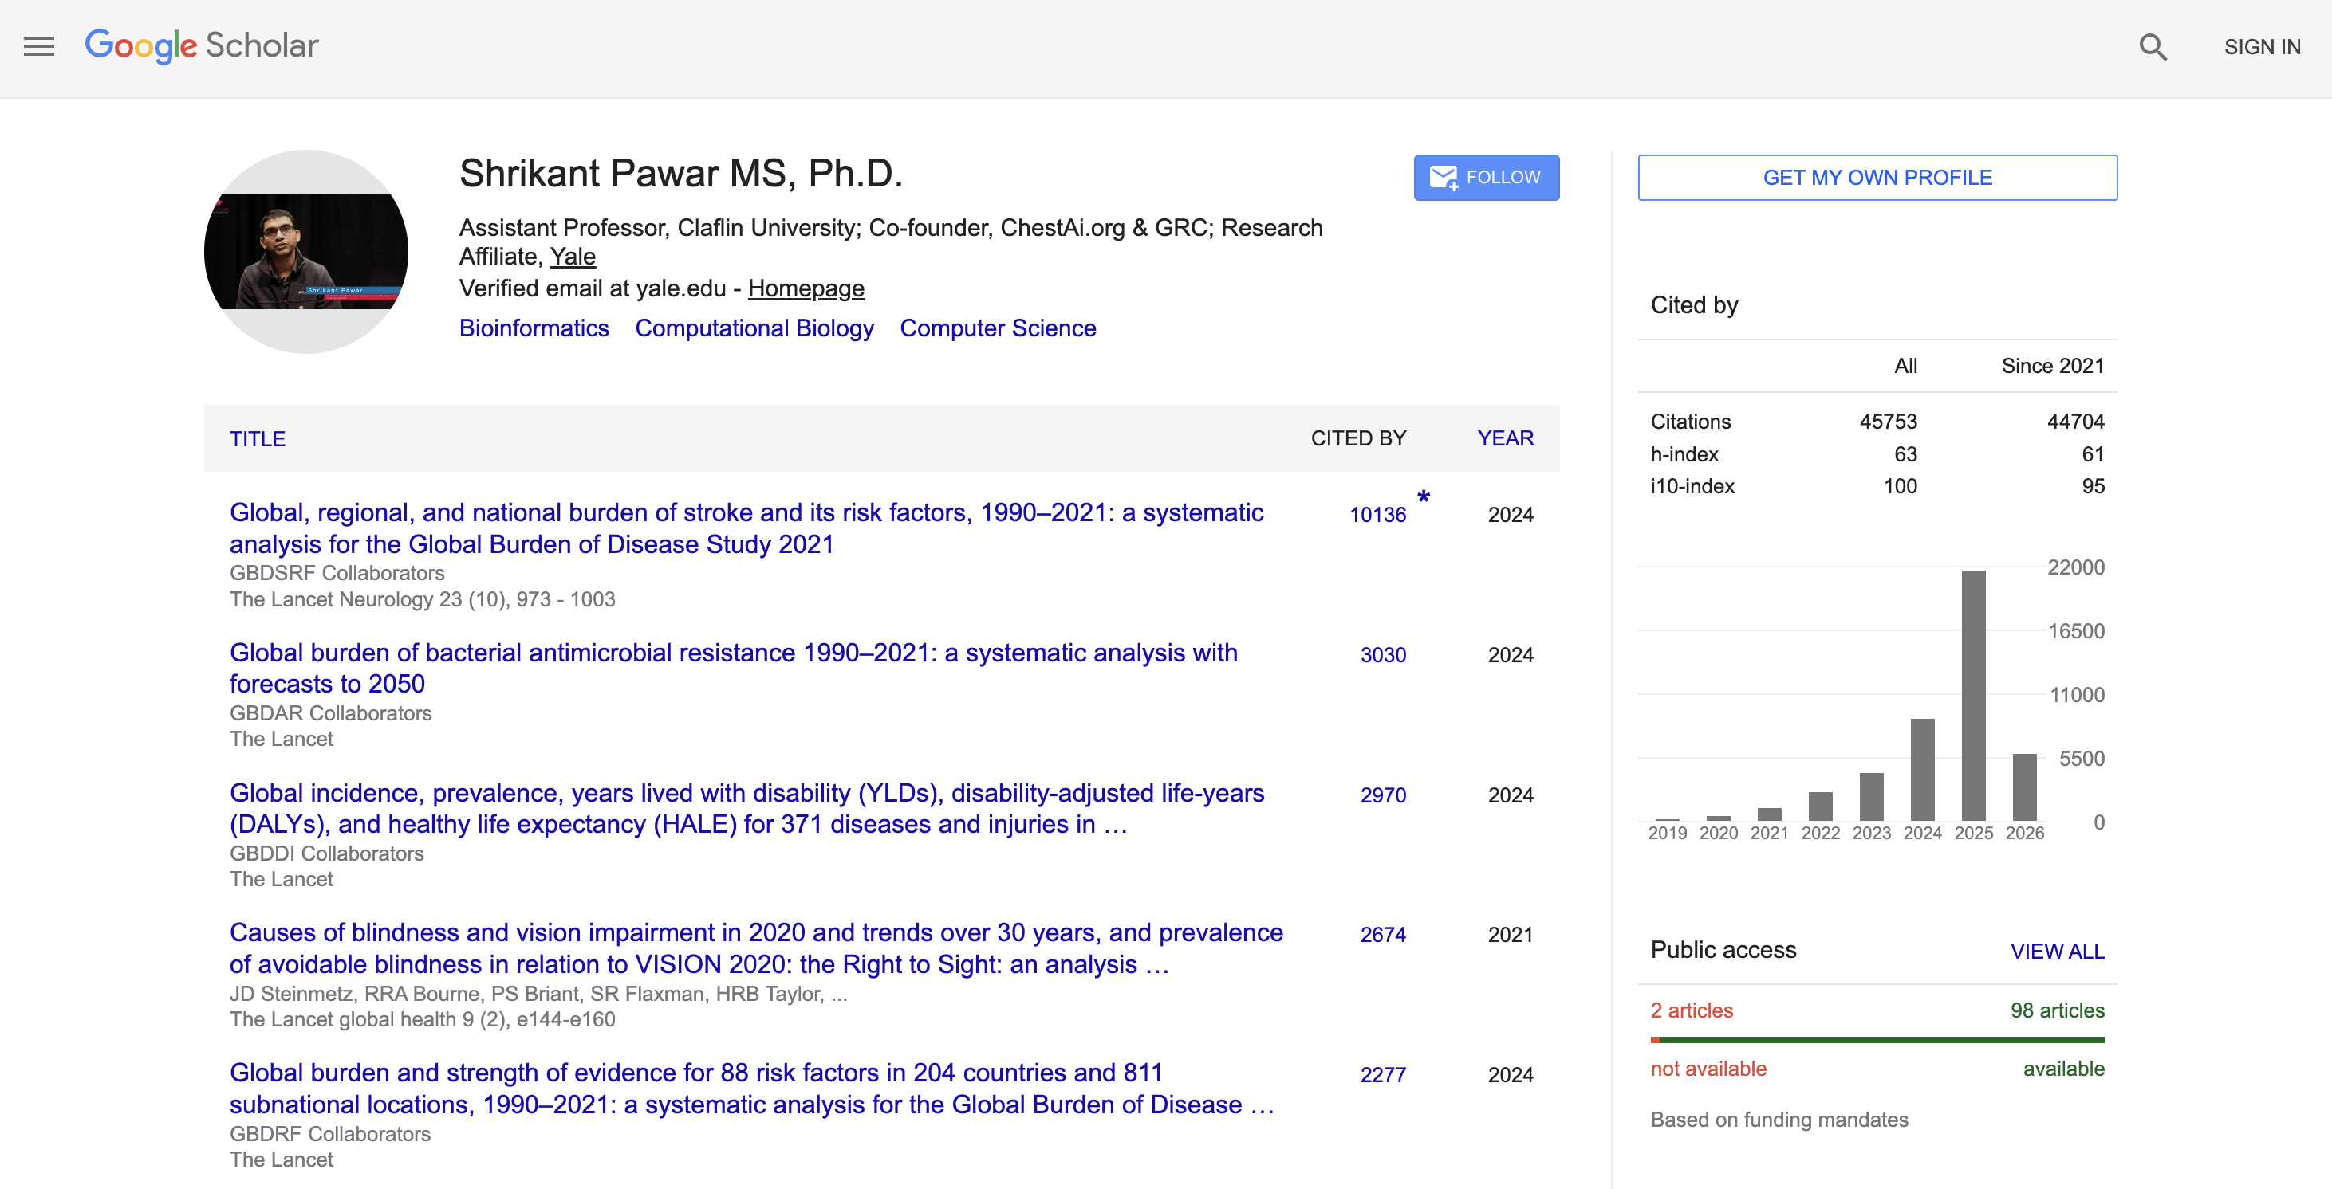
Project References
1. Analysis of drug resistance in HIV protease, Shrikant Pawar, Chris Freas, Robert W. Harrison, and Irene T. Weber, BMC: Bioinformatics
2. Structural studies of antiviral inhibitor with HIV-1 protease bearing drug resistant substitutions of V32I, I47V and V82I, Shrikant Pawar, Yuan-FangWang, Andres Wong-Sam, Johnson Agniswamy, Arun K. Ghosh, Robert W. Harrison, and Irene T. Weber, Elsevier: Biochemical and Biophysical Research Communications
3. KIFCI, a novel putative prognostic biomarker for ovarian adenocarcinomas: delineating protein interaction networks and signaling circuitries, Shrikant Pawar, Shashikiran Donthamsetty, Vaishali Pannu, Padmashree Rida, Angela Ogden, Nathan Bowen, Remus Osan, Guilherme Cantuaria, and Ritu Aneja, BMC: Journal of Ovarian Research
4. Machine learning for identification and characterization of molecular gene signatures in progression of benign tumors,. Shrikant Pawar, Aditya Stanam, Rushikesh Chopade, ACM International Conference on Artificial Intelligence and Information Systems
5. LinkedImm: a linked data graph database for integrating immunological data, Syed Ahmad Chan Bukhari, Shrikant Pawar, Jeff Mandell, Steven H. Kleinstein and Kei‐Hoi Cheung, BMC Bioinformatics.
6. Cyclical Learning Rates (CLR’s) for improving training accuracies and lowering computational cost, Rushikesh Chopade, Aditya Stanam, Anand Narayanan, Shrikant Pawar. Springer: Lecture Notes in Computer Science.
7. Clustering Reveals Common Check-Point and Growth Factor Receptor Genes Expressed in Six Different Cancer Types, Shrikant Pawar and Aditya Stanam, Springer: Lecture Notes in Computer Science.
8. Common cancer biomarkers of breast and ovarian types identified through artificial intelligence, Shrikant Pawar, Tuck Onn Liew, Aditya Stanam, Chandrajit Lahiri, Wileys: Chemical Biology and Drug Design
9. A side-effect free method for identifying cancer drug targets, MD Ashraf, Shama Mujawar, Shrikant Pawar, and C Lahiri, NPG: Scientific Reports
10. . In silico Identification of the Indispensable Quorum Sensing Proteins of Multidrug Resistant Proteus mirabilis, Shrikant Pawar, MD Ashraf, Shama Mujawar, Rohit Mishra, and C Lahiri, Frontiers in Cellular and Infection Microbiology
11. Delineating the plausible molecular vaccine candidates and drug targets of multidrug resistant Acinetobacter
baumannii, C Lahiri, Shama Mujawar, Shrikant Pawar, Derek Gatherer, Frontiers in Cellular and Infection Microbiology
12. Phenotypes of disease severity in a cohort of hospitalized COVID-19 patients: results from the IMPACC study,
IMPACC Collaborator Network, The Lancet Discovery Science

Slide 25
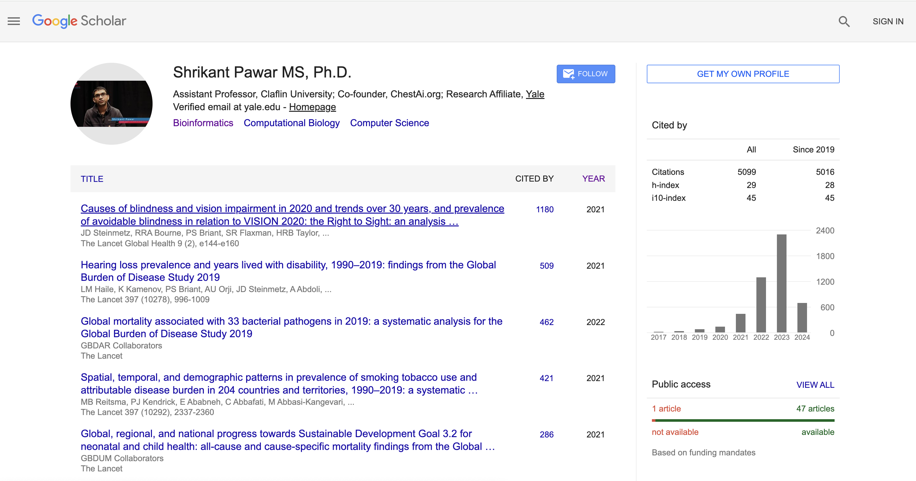
Research achievements
>90 peer reviewed articles published in Journals with high tier publishers (IEEE, ACM, Lancet, NPG, BMC, Elsevier, and Springer).
Google scholar citations 5099 with i10-index of 45. https://scholar.google.com/citations?user=SvcIPSsAAAAJ&hl=en
System and method to detect lung disorders in chest x-ray image: Patent Pending, ID-TEMP/E-1/26/2021-DEL & USPTO trademark application for ‘ChestAi’ (#88930063).

Slide 26
Thesis adviser and committee member
21 students (2021-22):
Ms. Aneeka Agrawal , Ms. Moneefa Jones, Ms. Emmanuella Mojekwu, Mr. Joshua Kiprano, Mr. Bibek Itani, Ms. Jamesha M. Jones, Mr. Sylvester U. Anosike, Mr. Daniel S. Oyeka, Ms. Smart & Ms. Etha, Mr. Owalabi. Oluwamayowa, Ms. Evan Simms, Mr. Davion Greene, Mr. Enoch Adelekan, Mr. Kurt Abraham, Ms. Jasmine A. Love, Mr. Ben'Aje Parker, Ms. Jalena Jones
Alumni students:
1. Mr. Emmanuel Ndubuisi, Undergraduate student: Claflin University, South Carolina, USA. Thesis: Protein Classification Using Embeddings from Language Models Trained on Amino Acid Sequences (Fall 2022). Presently software engineer at Microsoft, Atlanta.
2. Mr. Brandon T. Sanders, Undergraduate student: Claflin University, South Carolina, USA. (Fall 2023). Presently graduate student at University of Alabama at Birmingham.
3. Ms. TyChrisa Whitmire, Undergraduate student: Claflin University, South Carolina, USA. (Fall 2023). Presently software engineer at ScribeAmerica.
4. Mr. Bibek Itani, Undergraduate student: Claflin university, South Carolina, USA. (Fall 2023). Thesis: Driving mishaps detection & rerouting the traffic using smart phones. Presently software engineer at Delta Airlines, Atlanta.

Slide 27



Teaching (39 classes from year 2010-Present, Western Kentucky University, Instructor of Record at Georgia State University) at Claflin University
Probability & Statistics I & II, Biostatistics, Data Analysis (topics including descriptive & inferential statistics, distributions, regression techniques, etc.), Honors & Junior Seminar, Bioinformatics (topics including sequence alignment algorithms, scoring matrices, phylogenetic algorithms, bootstrapping, tree building, secondary & tertiary structure prediction, homology modeling, and protein folding)]
Intro to Digital Logic Design and Lab (Emphasis on digital computer hardware and software, fundamentals of Boolean algebra (MATH111), switching and switching functions, applications to logic design, minimization of Boolean function, logic design with arrays, finite state model for sequential state minimization, design abstractions, representations, process, Karnaugh maps, K-map simplification, combinatorial components, multiplexers, decoders, selectors, ROMs, PLAs, hybrid components, sequential logic, Mealy/Moore finite state machines, state minimization, encoding, control unit design)
Object Oriented Programming (topics including abstraction, encapsulation, inheritance, polymorphism, software design techniques, etc.)
Junior, senior and honors computer science seminar classes CSCI 391, HNTH 391
Data Science (Data wrangling, visualization, Machine Learning QDA, LDA, ROC, Decision Trees, Regularization, Text Analysis Feature Engineering, Classification and Model Evaluation, Regression: Basics and Prediction, Evaluation and Interpretation, Clustering, etc.) course.
https://pawar1550.wixsite.com/claflin-courses

Slide 28
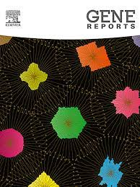




Service, Editorial Board Member and Reviewer (Selected)
Course coordinator for Bioinformatics major, Claflin University
National Institute of General Medical Sciences (NIGMS), National Institute of Health Maximizing Opportunities for Scientific and Academic Independent Careers (MOSAIC) Institutionally-Focused Research Education Applications (UE5) for institutions to support educational activities for postdoctoral scholars that will help them develop professional skills and networks to transition to independent research careers; Innovative Programs to Enhance Research Training (IPERT R25s) to develop and implement courses focused on skills development or mentoring activities; and R13 grants
Emerging Imaging Technology and Applications (EITA) Panel. Imaging, Surgery, and Bioengineering (ISB) Integrated Review Group (IRG), National Institutes of Health (NIH)
Elsevier: Gene Reports, Materials Today Communications, Infection, Genetics and Evolution, Health Policy and Technology, Healthcare Analytics, Letters in Drug Design & Discovery
Future Science OA
Frontiers in Bioinformatics, Molecular Biosciences, Neurology, Oncology
Frontiers in Genetics: Associate/Handling Editor
Model of Infectious Agent Disease Study (MIDAS)

Slide 29








Running Grants
1. NSF SC EPSCoR ADAPT Track 1 Award, (2023-2028), $484,000: https://scepscor.org/research-expertise-profiles-table/
2. The Department of Defense (DoD), Army Materiel Command (AMC), (2025-2026), $410,596: https://www.defense.gov/News/Releases/Release/Article/3928512/department-of-defense-awards-50-million-in-research-equipment-grants-to-hbcus-a/
3. NSF Partnerships for Research and Education in Materials (PREM), (2026-2027), $193,661: https://www.nsf.gov/funding/opportunities/prem-partnerships-research-education-materials/5439/nsf24-512
4. Yale University, Rothberg Fund, USA: “CHEST-AI: AI tool for detection of lung diseases from chest X- ray data”: https://medium.com/tsai-city/kickstarting-healthcare-innovation-with-the-rothberg-catalyzer-prototype-fund-6f5a1f37c5c2
5. Entrepreneurship Foundation Fund, USA: “CHEST-AI: AI tool for detection of lung diseases from chest X- ray data”: https://www.entrepreneurshipfoundation.org/
6. Culinda Technologies, Texas, USA (https://www.culinda.io/): Machine learning solutions for medical devices that provide deep insight into IoT and IoMT applications.
7. SCICU Undergraduate Student/Faculty Research Program.
8. Claflin University Smart Home, Center of Excellence Seed Grant.
9. Google Career Readiness Capacity Grant.
*All Role: PI.

Slide 30



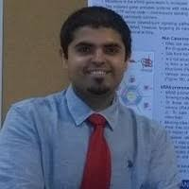
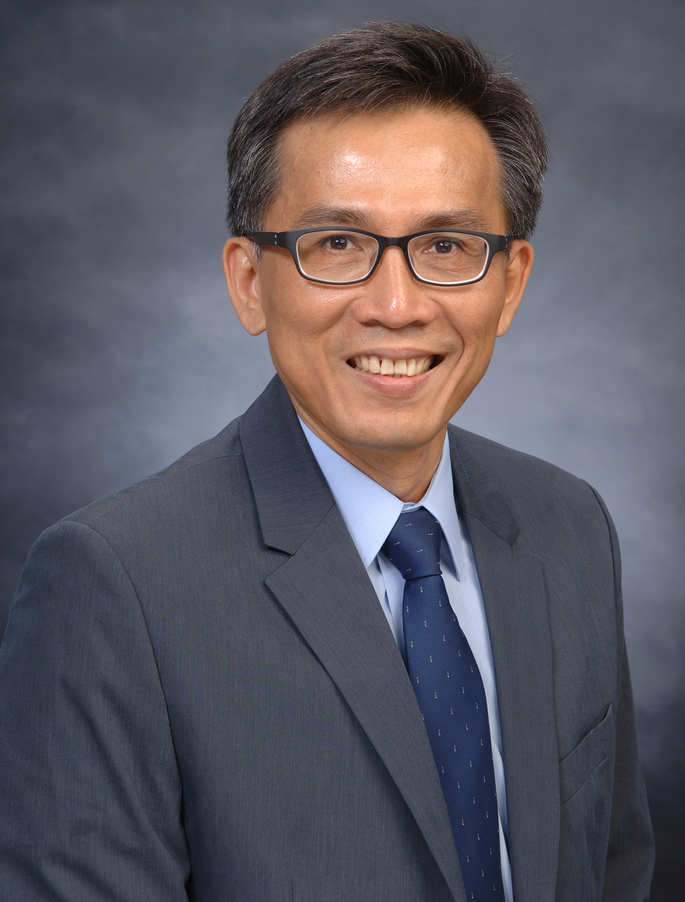
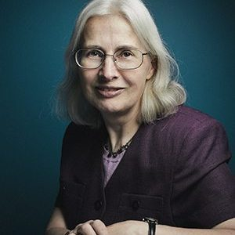
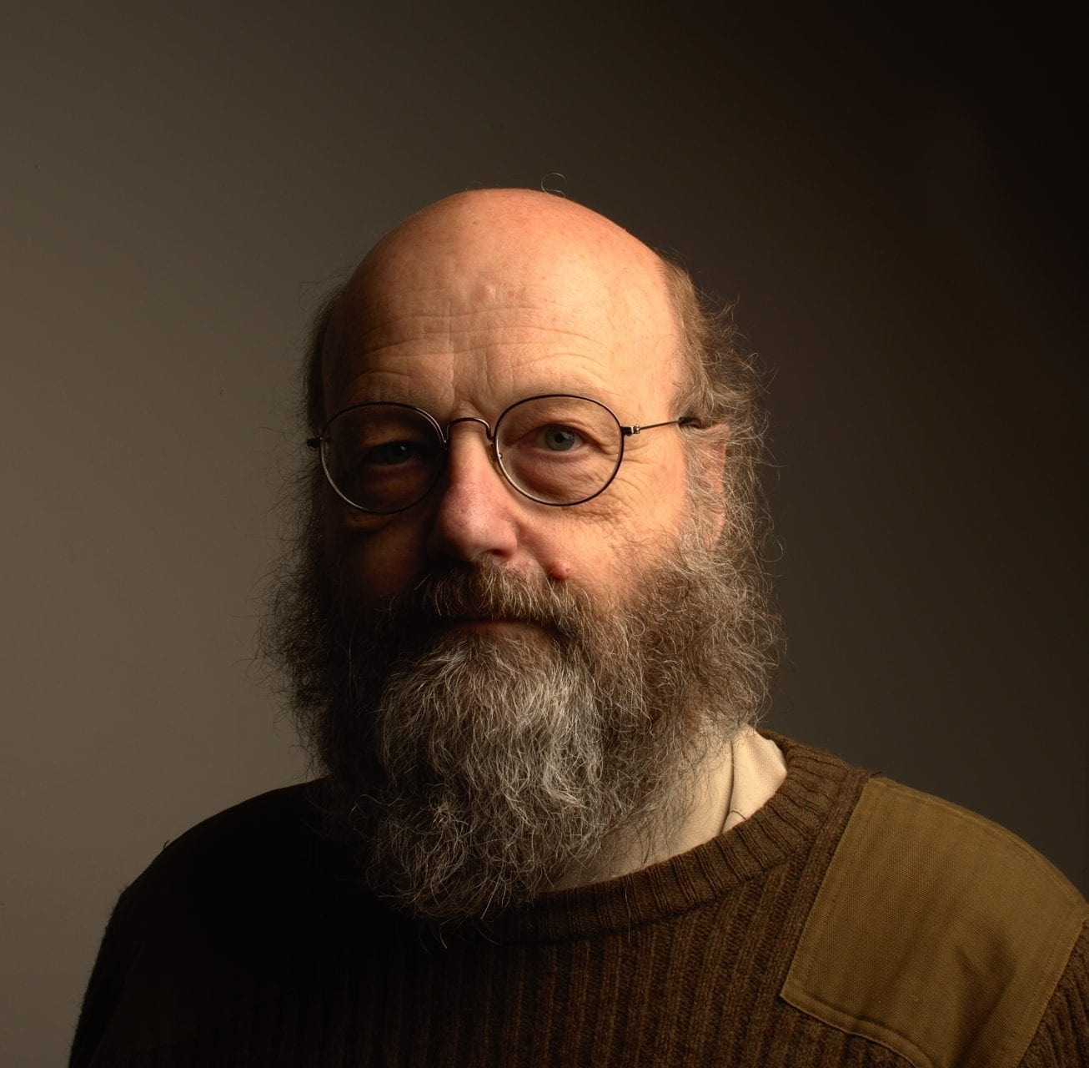
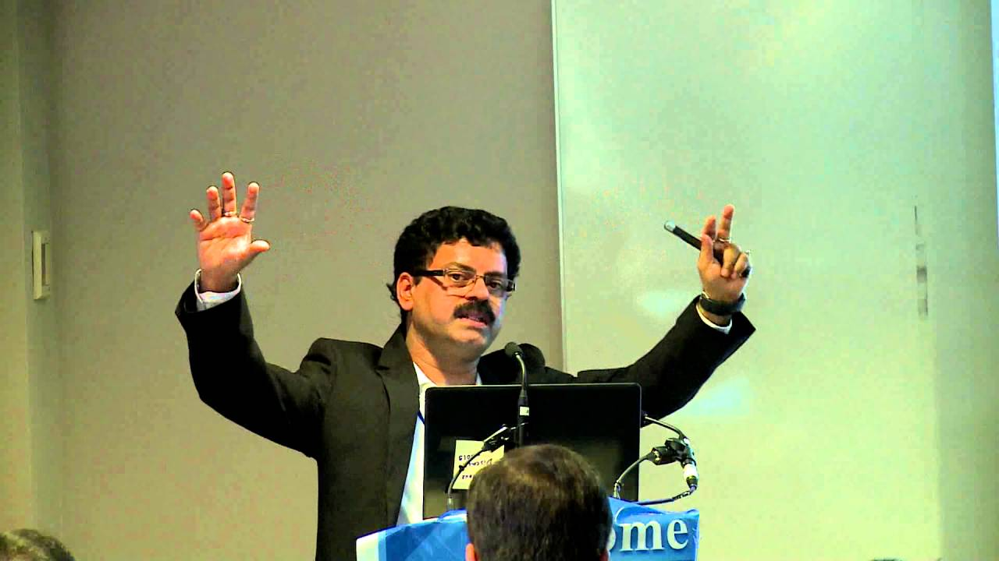
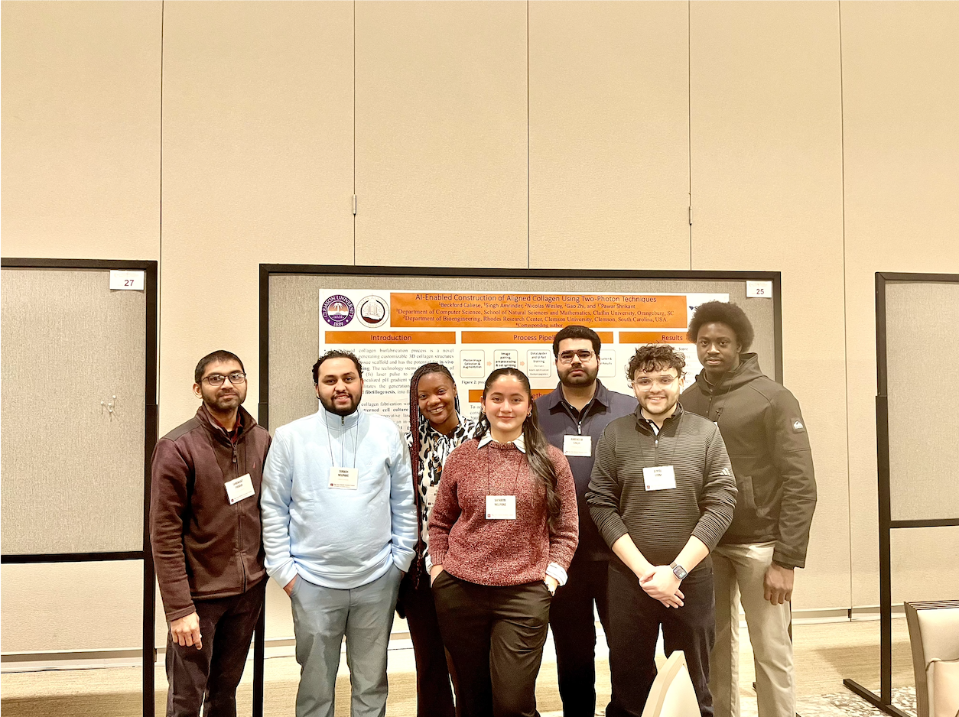



Collaborators
Software Development
Sequence Analysis
Machine Learning
Network Biology
Thank you!
Current projects in collaboration with:
Dr. Christian Griñán Ferré, Univesity of Barcelona;
Dr. Kleinstein, Yale University;
Dr. Uduman, Dana Farber Harvard;
Dr. George Tegos, Gamma Therapeutics;
Dr. Lahiri, Sunway University;
Dr. Allen. Bale, Dr. Hui. Zhang, DNA Diagnostic Lab at Yale University;
Dr. Insoo. Kang; Dr. Kei-Hoi Chung; and Dr. Leying Guan at Yale University
Spring 2026: Demi, Bimal, Amrinder, Swikriti, Caliese, & Subash (right to left.)
HPC Resources
Notes:
Undergraduate and graduate students:
Joshua Kiprano, Emmanual Nbuski: Presently at Microsoft, Atlanta
Bibek Itani: Presently at Delta Airlines, Atlanta.
Brandon Sanders: Presently doctoral student at University of Alabama at Birmingham.

