Slide 1
INGREDIENTS BASED SKINCARE RECOMMENDATION SYSTEM
Presented by April Ossai

Slide 2
PROBLEM STATEMENT
71%
81%
60%+
of consumers discover new skincare products through social media
are influenced by peer & influencer reviews when buying
have limited understanding of basic skin science concepts
The Core Problem
Skincare consumers increasingly rely on informal digital sources (TikTok, Instagram) for product guidance.
Highly-engaged social content often lacks medical accuracy, prioritizing trends over evidence.
No widely available, evidence-based recommendation system exists to provide accurate, personalized guidance.
Trial-and-error approaches waste money, cause discouragement, and can worsen skin conditions.

Slide 3
Research QUESTIONs
How can a personalized skincare recommendation system be developed to match products with individual skin types, concerns, and sensitivities?
How effective is the system in guiding users to select products that improve skin outcomes compared to general or non-personalized recommendations?

Slide 4
PURPOSE OF THE STUDY
To develop a system that provides tailored, evidence-based skincare recommendations, guiding users toward products more likely to be effective and safe for their unique skin needs.

Slide 5
CONTENT BASED FILTERING
IF-IPF ALGORITHM
COSINE SIMILARITY
For users who know their concerns (effects & skin type)
No popularity bias- doesn't just recommend best-sellers
Ingredient-focused
For users who know a product they like
Find similar formulations
No popularity bias
Ingredient-focused

Slide 6
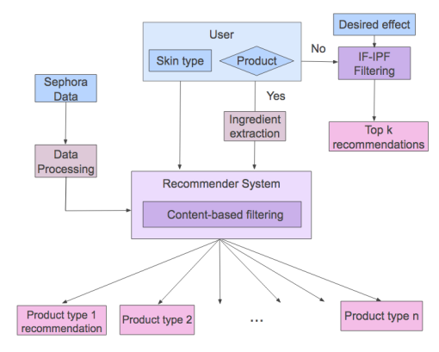
SYSTEM
DESIGN

Slide 7
COSINE SIMILARITY
System finds its ingredient vector
User types a product they like
Compares to all 1,500 products
Returns highest scoring matches
Notes:
I used a design and development research methodology, which means the study was not limited to analyzing or describing the problem, but focused on building a functional computing solution and validating its effectiveness.
This approach followed a process consisting of four main phases:
First, requirements analysis was conducted. In this phase, I reviewed clinical trial risk management frameworks, including regulatory guidance such as International Council for Harmonization-GCP, to identify key functional requirements. This included features like risk categorization, severity scoring, escalation tracking, etc.
Second, I moved into system design, where I defined the architecture of the application. The system was designed as a full-stack solution with a FastAPI backend, relational database using SQLite and SQLAlchemy, and a React-based frontend.
Third, the implementation phase involved developing the actual system. I built API endpoints to handle trial and risk operations, implemented the severity scoring logic based on likelihood and impact, and created a dynamic frontend interface that allows users to interact with the system in real time.
Finally, I conducted scenario-based functional validation. Instead of using survey data or statistical testing, I simulated realistic clinical trial risk scenarios such as protocol deviations or delayed enrollment to test whether the system correctly handled risk logging, scoring, escalation, and dashboard updates. The outputs were then compared against expected system behavior to verify correctness and alignment with requirements.

Slide 8
If-ipf
Seed ingredients are defined for each skincare effect
System identifies products containing those seeds
Analyzes all ingredients across those products
Scores combine frequency (in effect products) with rarity (across all products)
Result: Ingredients common in effect products but rare overall rank highest

Slide 9
METHODOLOGY
Tech Stack
Data Preparation
1
Python 3.11 (Pandas, NumPy, Scikit-learn)
Flask REST API backend
React frontend (component-based UI)
TF-IDF vectorizer + cosine similarity
Load CSV, parse & clean ingredient strings, verify skin type columns
IF-IPF Algorithm
2
Calculate Ingredient Frequency × Inverse Product Frequency per effect category
Dataset
Similarity Features
~1,500 skincare products (Kaggle / Sephora)
Fields: product name, brand, price, ratings, ingredients
Skin type flags: Combination, Dry, Normal, Oily, Sensitive
Cleaning: lowercase, remove parentheticals, comma-split ingredients
3
TF-IDF vectorize ingredient lists → cosine similarity matrix
Frontend & API
4
React UI + Flask endpoints for effect-based and product-based queries

Slide 10
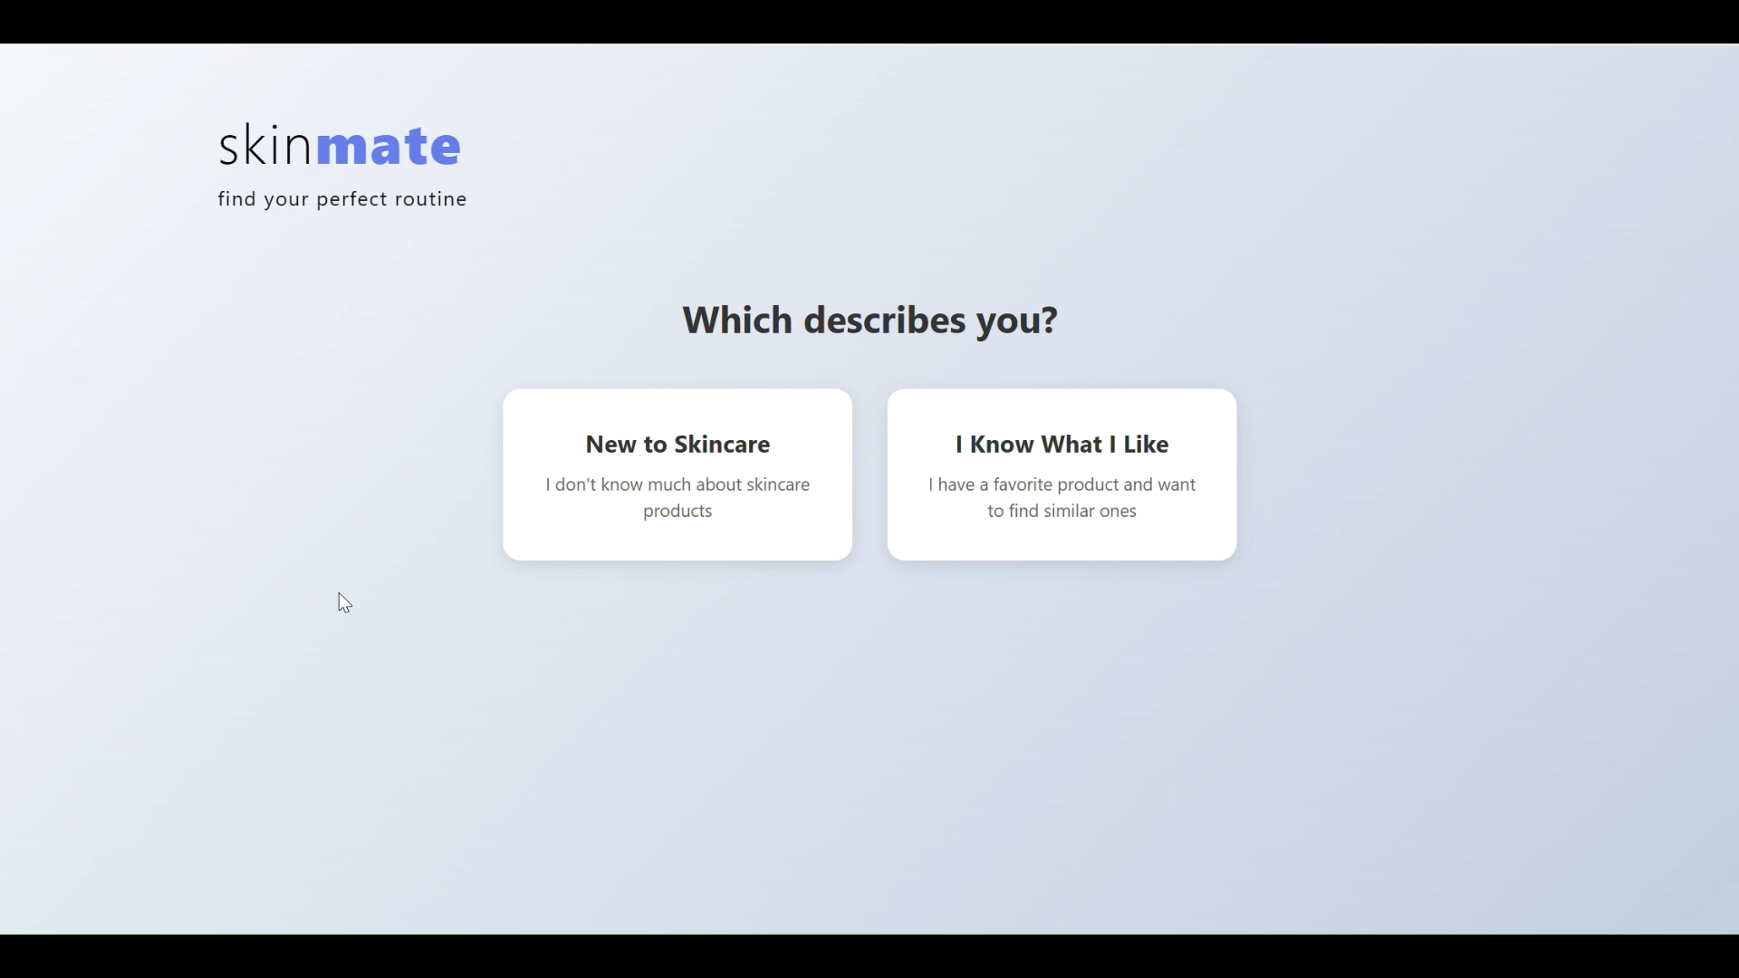

Slide 11
DISCUSSION
WHAT THE SYSTEM ACHIEVES
LIMITATIONS
Addresses the cold-start problem — works for first-time users with no purchase history
Enables search by desired effect, lowering the knowledge barrier for users
Distributes recommendations across product categories to support full routines
Evidence-based approach reduces reliance on misleading marketing or influencer claims.
Real-world skin improvement outcomes remain untested
Performance depends on completeness/accuracy of ingredient data
Cannot account for individual skin biology or ingredient interactions
GLOBAL IMPACT
Individuals: Simplifies product discovery without requiring deep ingredient knowledge
Industry: Data-driven matching may increase satisfaction and reduce returns
Society: Promotes transparency and ingredient awareness among consumers

Slide 12
CONCLUSIONS & FUTURE WORK
CONCLUSIONS
FUTURE WORK
Ingredient-based content filtering provides a viable solution to the cold-start problem
The system bridges a clear gap: accessible, evidence-based recommendations for all users
Advances both theory (recommender systems in personal care) and practice (consumer empowerment)
Incorporate user feedback loops to track whether recommended products improve skin outcomes
Longitudinal studies to validate real-world effectiveness
Integrate collaborative filtering and image-based skin analysis for richer personalization
Add environmental and lifestyle factors (humidity, diet, stress) to recommendation logic
Expand dataset beyond Sephora to improve diversity and coverage

Slide 13

THANK YOU!
Questions

