Slide 1
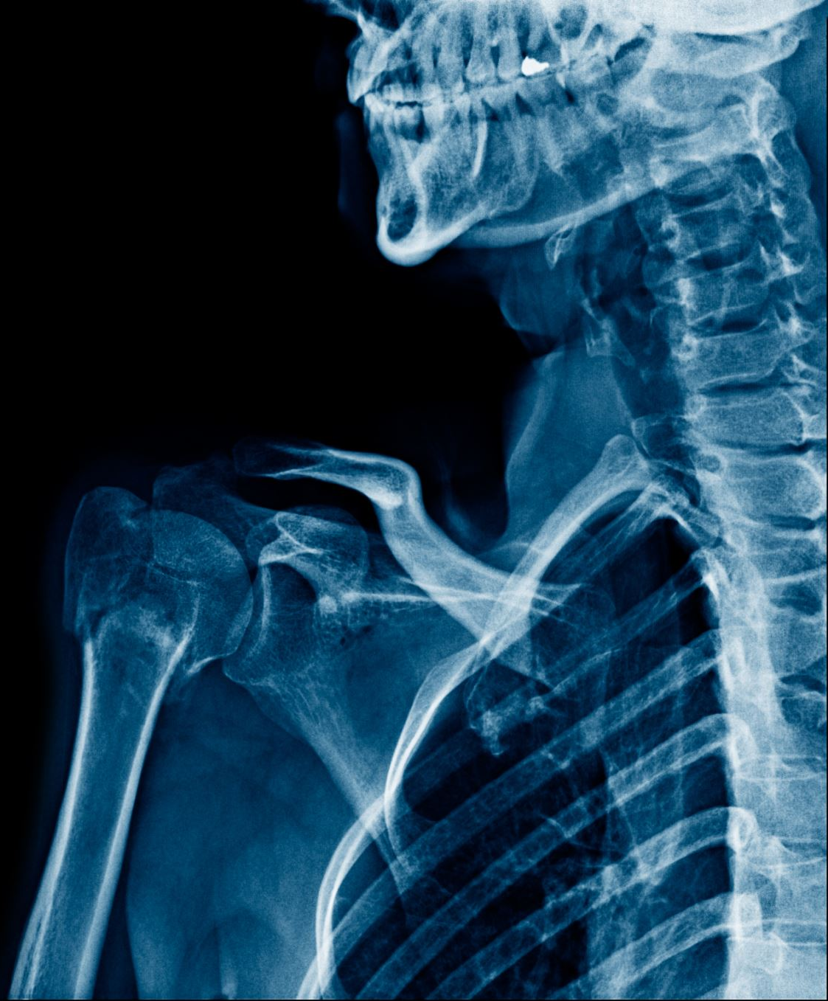
Machine Learning for the Diagnosis of Peripheral Arterial Diseases (PAD) Using Computed Tomographic Angiography (CTA) Images
Name: Caliese Beckford
Advisor: Dr. Shrikant Pawar
Committee members: Dr. K. Chowdhury, Dr. R. Harris
School of Natural Sciences and Mathematics

Slide 2
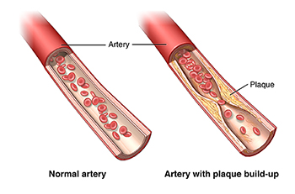
Background
Peripheral arterial disease is a circulatory condition where narrowed arteries reduce blood flow to the limbs, typically affecting the legs. This is caused by atherosclerosis.
It commonly impacts older adults (>65), smokers, persons with diabetes or high cholesterol.
Symptoms include leg pain, cramping, numbness, or weakness, and may lead to amputation.
(Johns Hopkins Medicine 2024)

Slide 3
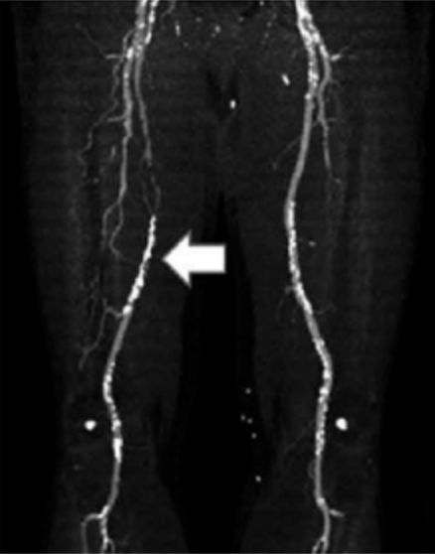
Diagnosis of PAD
PAD is diagnosed through ankle-brachial index tests, blood tests, ultrasound, or angiography.
Angiography can be used to detect blockage of the arteries using imaging tests and a dye then interpreted by a specialist.
CTA image of a patient with PAD
(Miceli, et. al, 2019).

Slide 4
Our Goal
Aim #1: To investigate the effectiveness of neural networks for detecting PAD from CTA images.
Aim #2: To optimize testing performance.

Slide 5
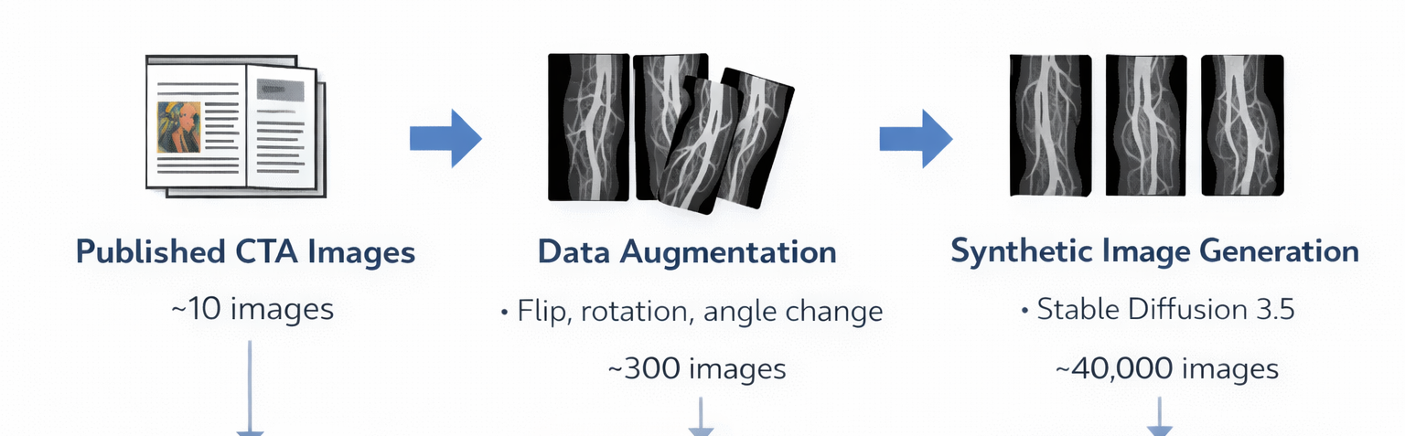
Image Collection and Synthesization

Slide 6
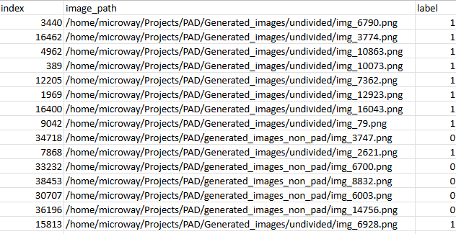
Dataset
1 positive
0 negative
where the image is found
40,000 images 80:20 split

Slide 7
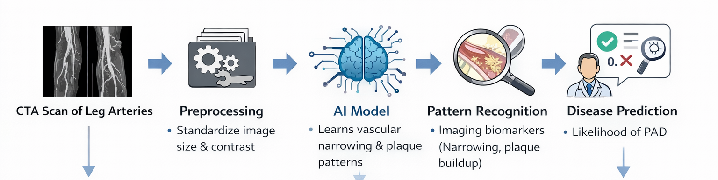
ML Model for Image Classification

Slide 8
Model Architecture
Dense Block 1
(edges and vessel boundaries)
Dense Block 2
(vessel structure)
Dense Block 3
(vessel narrowing and plaque build up)
Image Classification
(positive or negative)

Slide 9
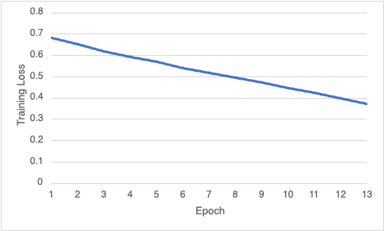
Results
Training loss decreased steadily from approximately 0.68 to 0.37 over 13 epochs, indicating effective optimization on the training data.
Notes:
Shows how poorly a machine learning model performs on the training data

Slide 10
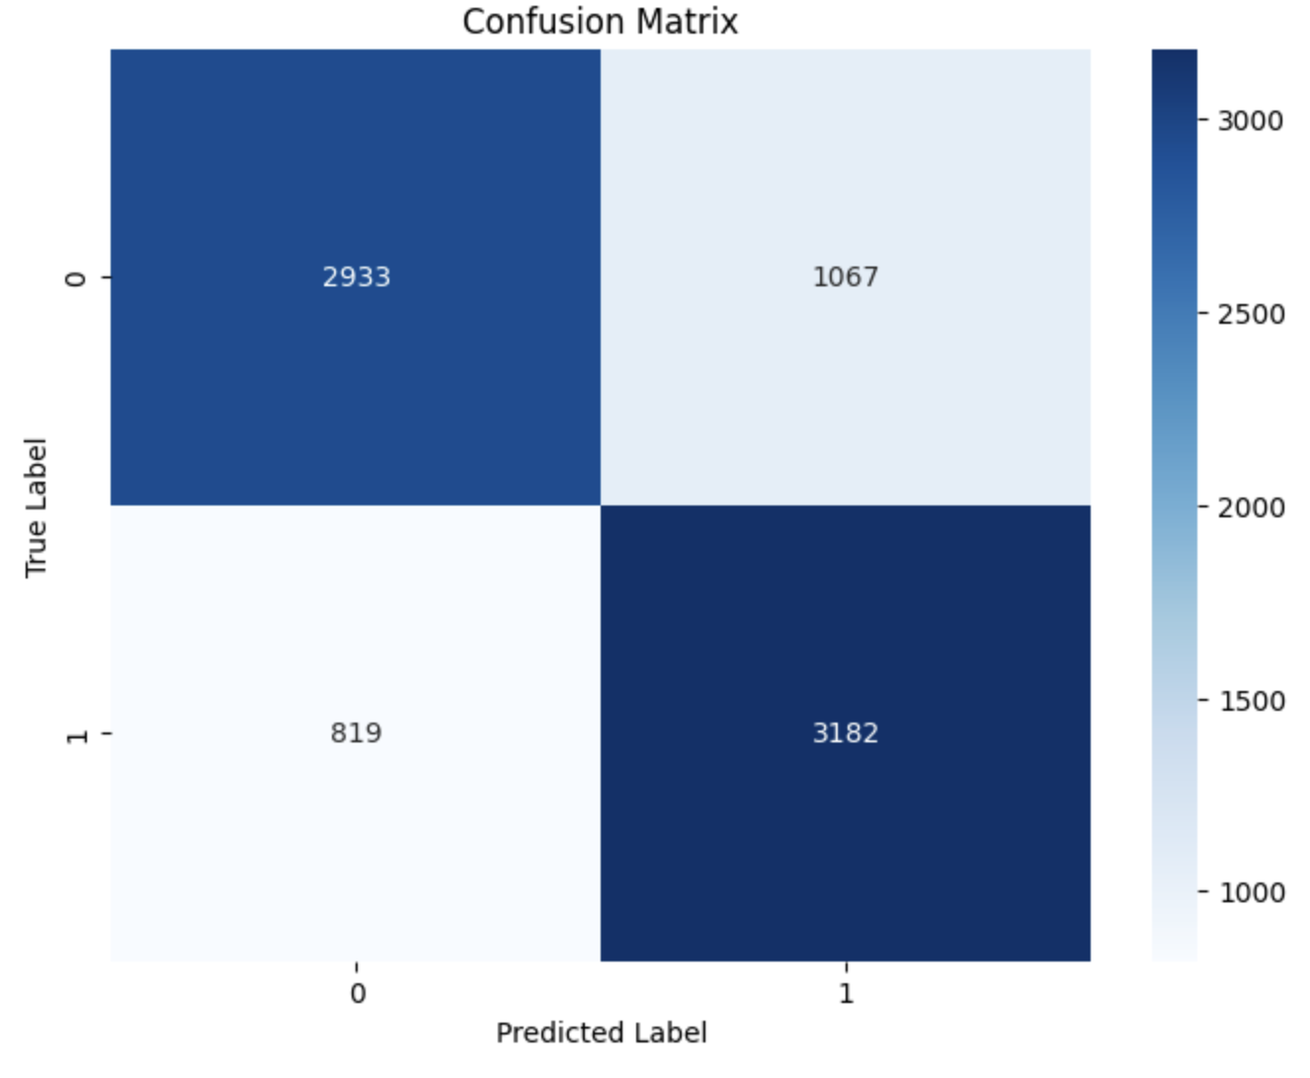
Results
Metric | Value
Accuracy | 0.76
F1-score (weighted) | 0.76
ROC AUC | 0.86
Notes:
Accuracy - percentage of correct predictions
Weight F1 – suggests the model is reasonably reliable for identifying disease while limiting false positives
AUC - the model's ability to distinguish between classes

Slide 11
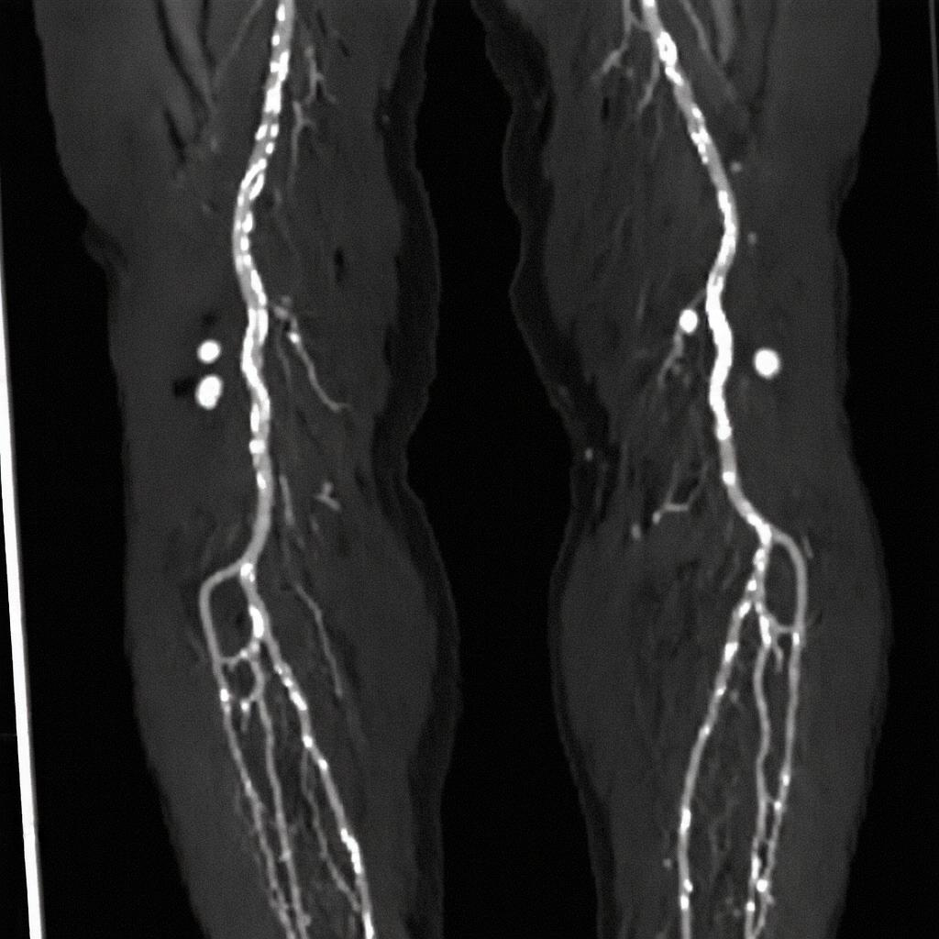
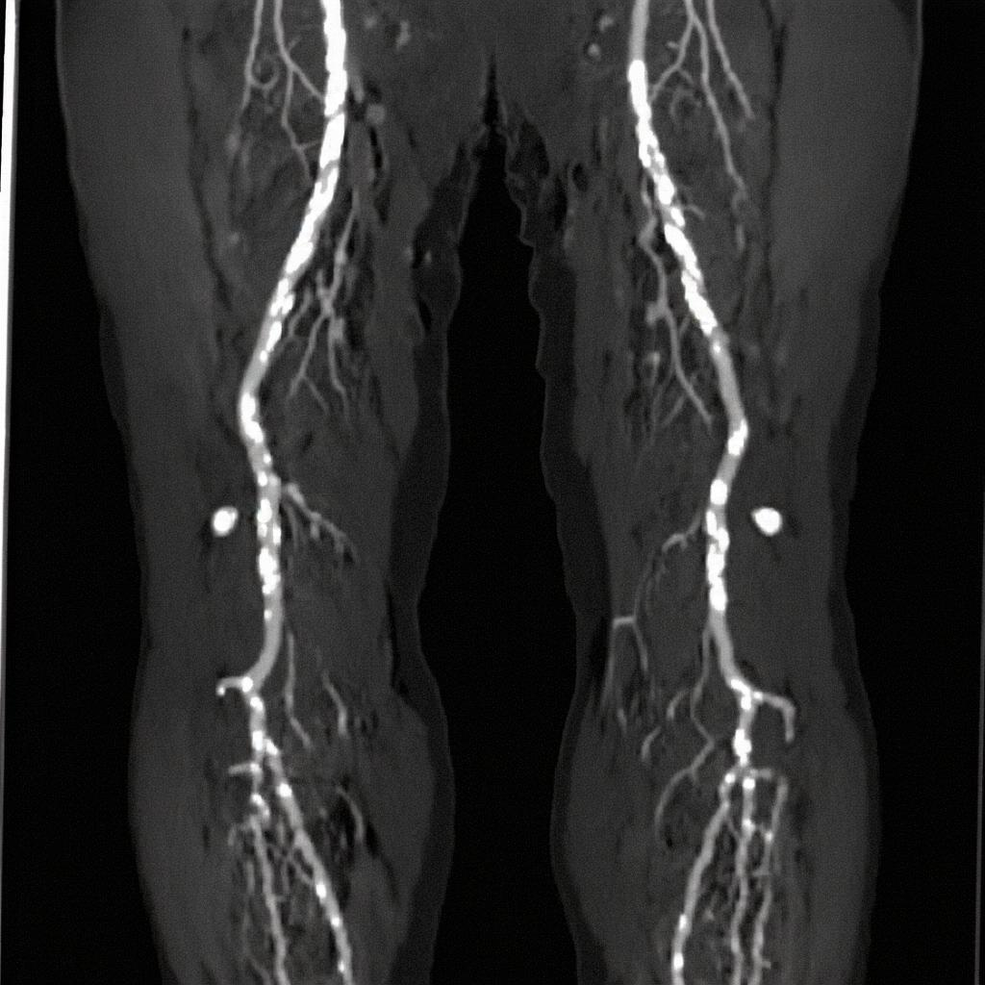
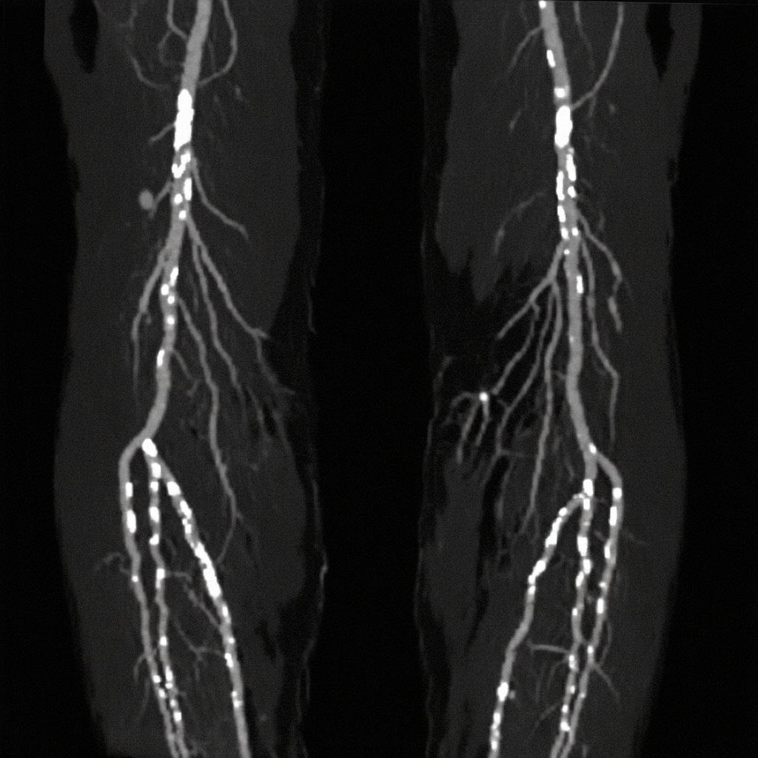
Limitations and future directions
PAD positive
PAD negative
synthetic image generated for model training

Slide 12

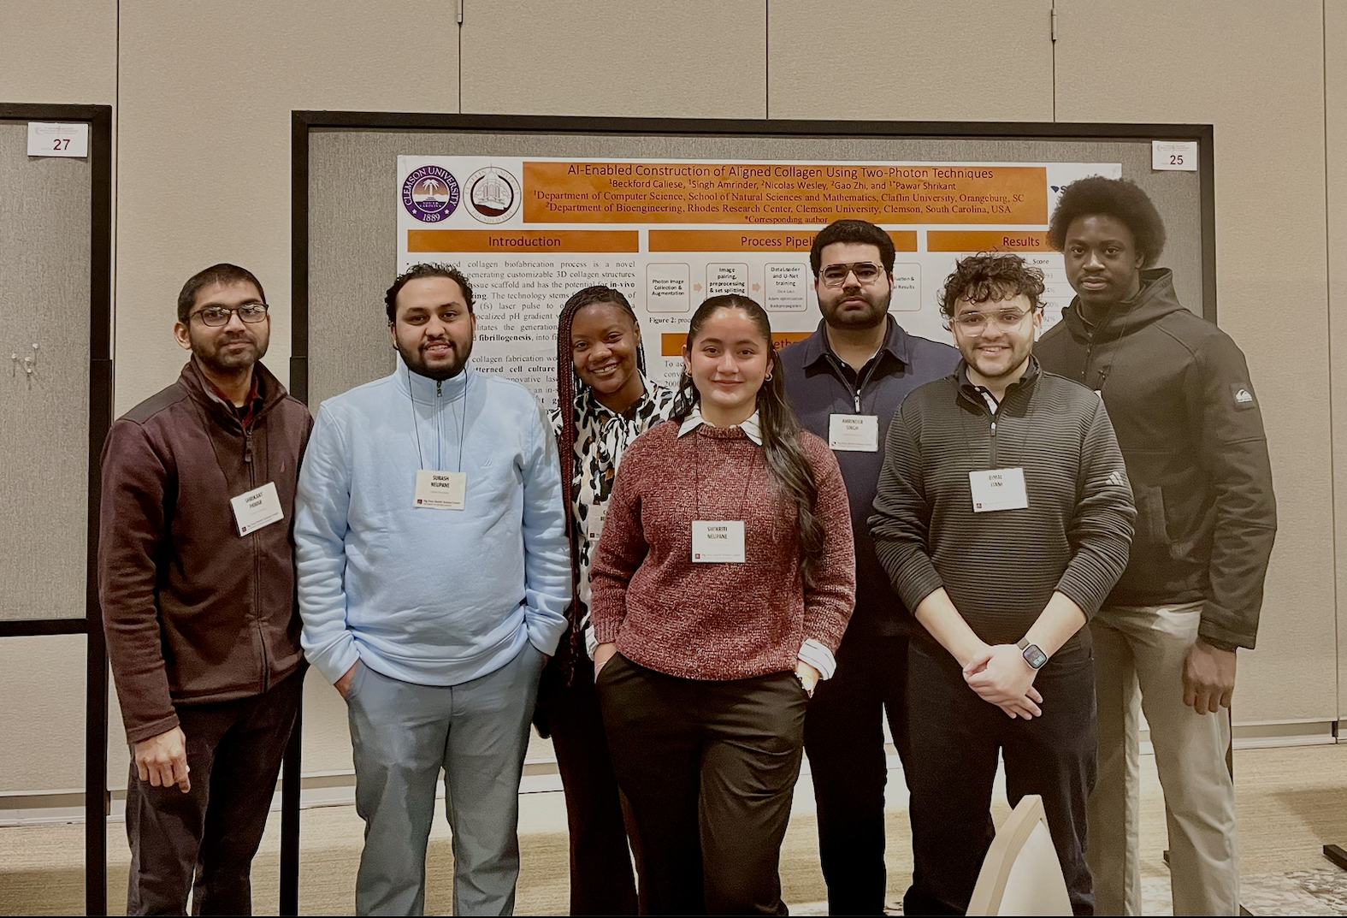
Acknowledgements
Amrinder Singh – image augmentation and synthesization
Committee members: Dr. K. Chowdhury, Dr. R. Harris
I acknowledge National Science Foundation (NSF) RII Track-1: AI-enabled Devices for the Advancement of Personalized and Transformative Healthcare in South Carolina (ADAPT), grant # 2242812 for financial support of this study.

Slide 13
References
CDC. 2024 Apr 24. About peripheral arterial disease (PAD). Heart Disease. Atlanta (GA): Centers for Disease Control and Prevention; [accessed 2025 Nov 24]. https://www.cdc.gov/heart-disease/about/peripheral-arterial-disease.html.
Cardoso MJ, Li W, Brown R, Ma N, Kerfoot E, Wang Y, Murrey B, Myronenko A, Zhao C, Yang D, Nath V, He Y, Xu Z, Hatamizadeh A, Myronenko A, Zhu W, Liu Y, Zheng M, Tang Y, Yang I, Zephyr M, Hashemian B, Alle S, Darestani MZ, Budd C, Modat M, Vercauteren T, Wang G, Li Y, Hu Y, Fu Y, Gorman B, Johnson H, Genereaux B, Erdal BS, Gupta V, Diaz‑Pinto A, Dourson A, Maier‑Hein L, Jaeger PF, Baumgartner M, Kalpathy‑Cramer J, Flores M, Kirby J, Cooper LAD, Roth HR, Xu D, Bericat D, Floca R, Zhou SK, Shuaib H, Farahani K, Maier‑Hein KH, Aylward S, Dogra P, Ourselin S, Feng A. 2022. MONAI: an open‑source framework for deep learning in healthcare. arXiv preprint arXiv:2211.02701.
Khagi B, Belousova T, Short CM, Taylor A, Nambi V, Ballantyne CM, Bismuth J, Shah DJ, Brunner G. 2024. A machine learning‑based approach to identify peripheral artery disease using texture features from contrast‑enhanced magnetic resonance imaging. Magn Reson Imaging. 106:31–42. https://doi.org/10.1016/j.mri.2023.11.014.
Thomas VE, Beckman JA. 2024. Racial and socioeconomic health disparities in peripheral artery disease. J Am Heart Assoc. 13(21):e031446. doi:10.1161/JAHA.123.031446.
Huang G, Liu Z, van der Maaten L, Weinberger KQ. 2017. Densely connected convolutional networks. Proc IEEE Conf Comput Vis Pattern Recognit. p. 4700–4708.

